Slide 1
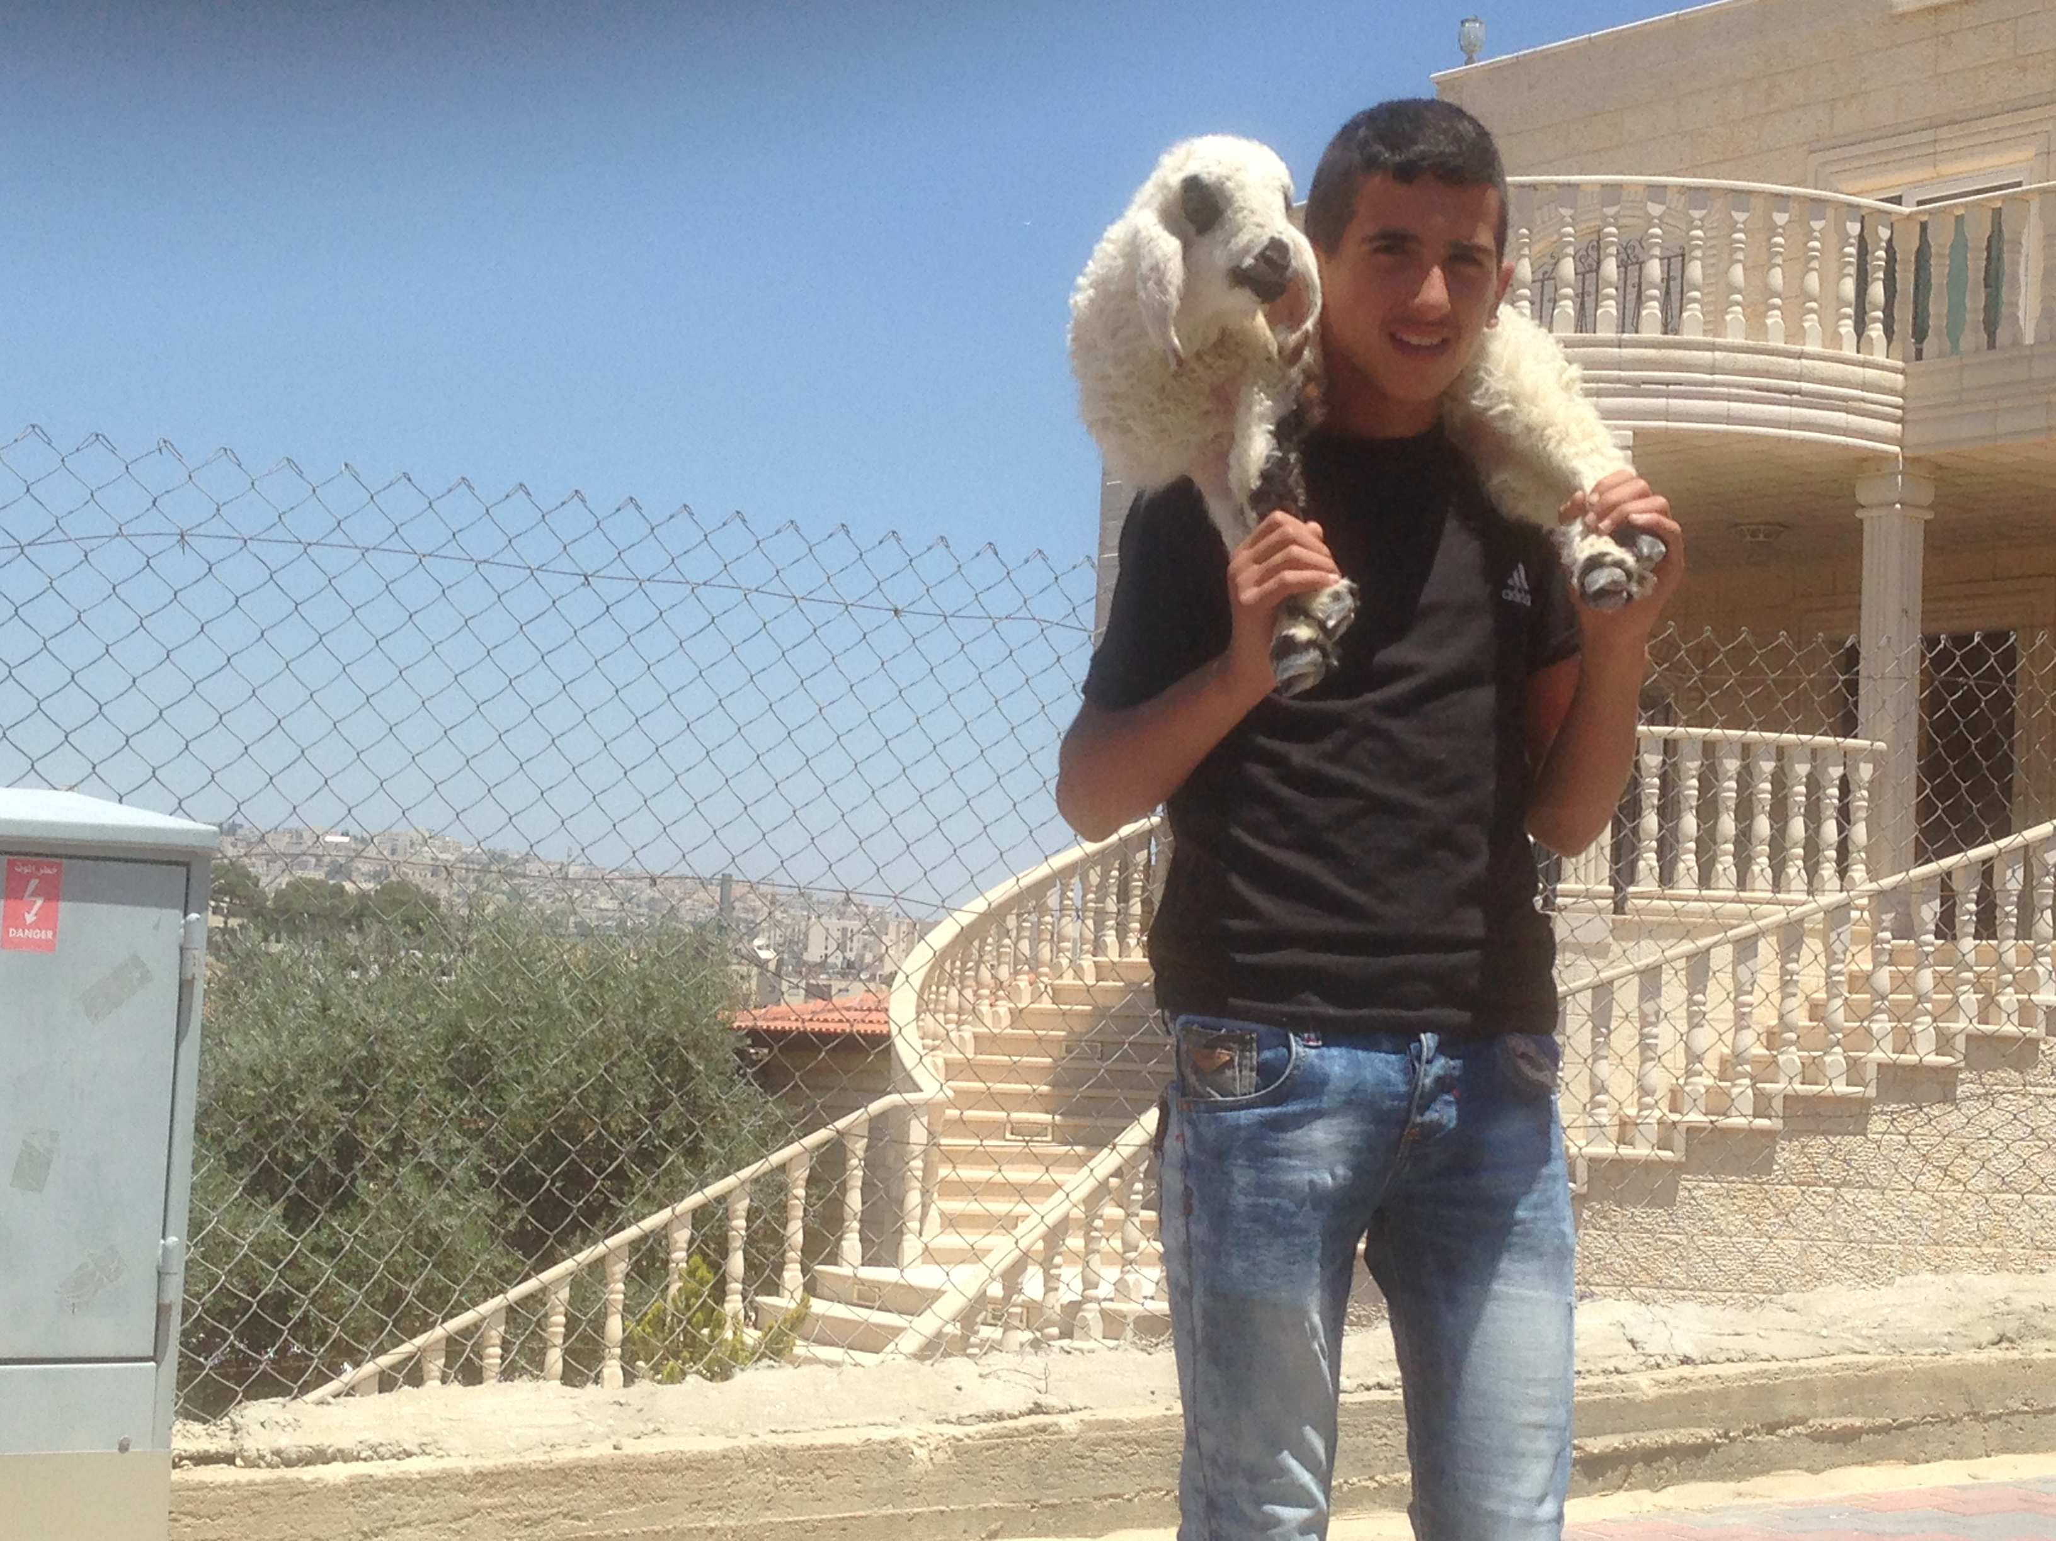
Israel Through Palestinian eyes Pt 4
By Bro. Jared Keyes

Slide 2
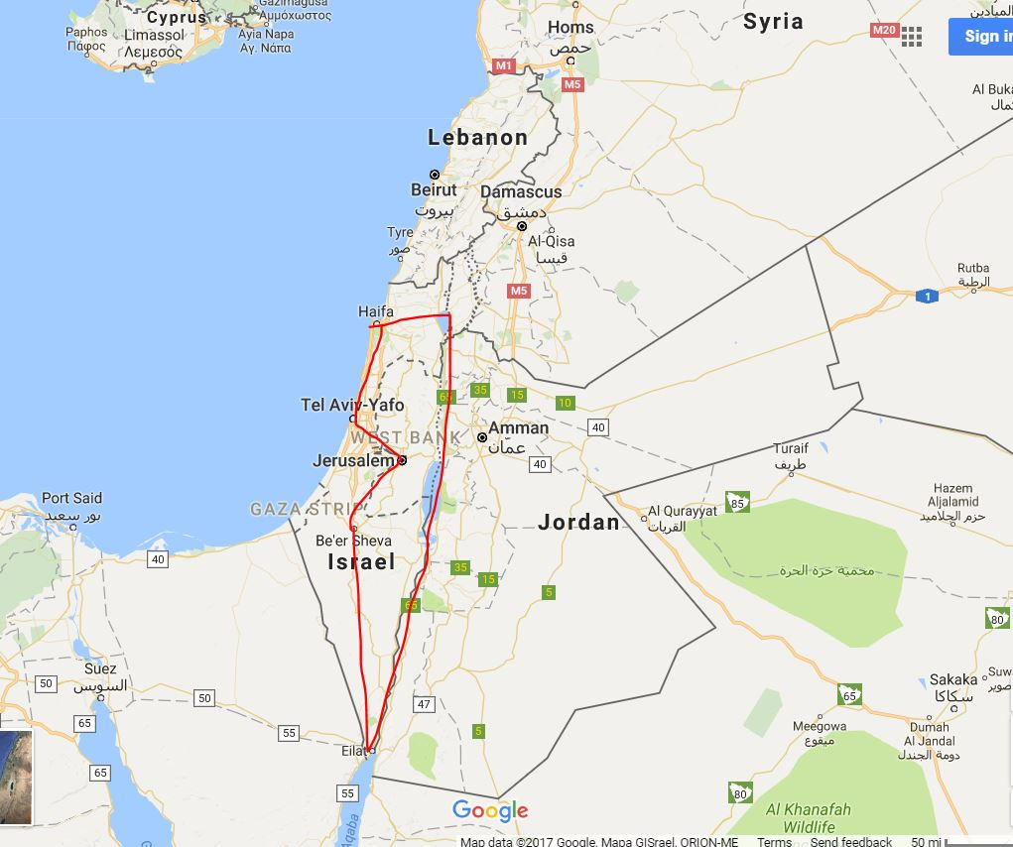
Trip details
Map

Slide 3
On the way to the Dead Sea -Bedwins)

Slide 4
Bethlehem – Palestinian demonstrations

Slide 5
Beit Sahour – House of the Rising Sun

Slide 6
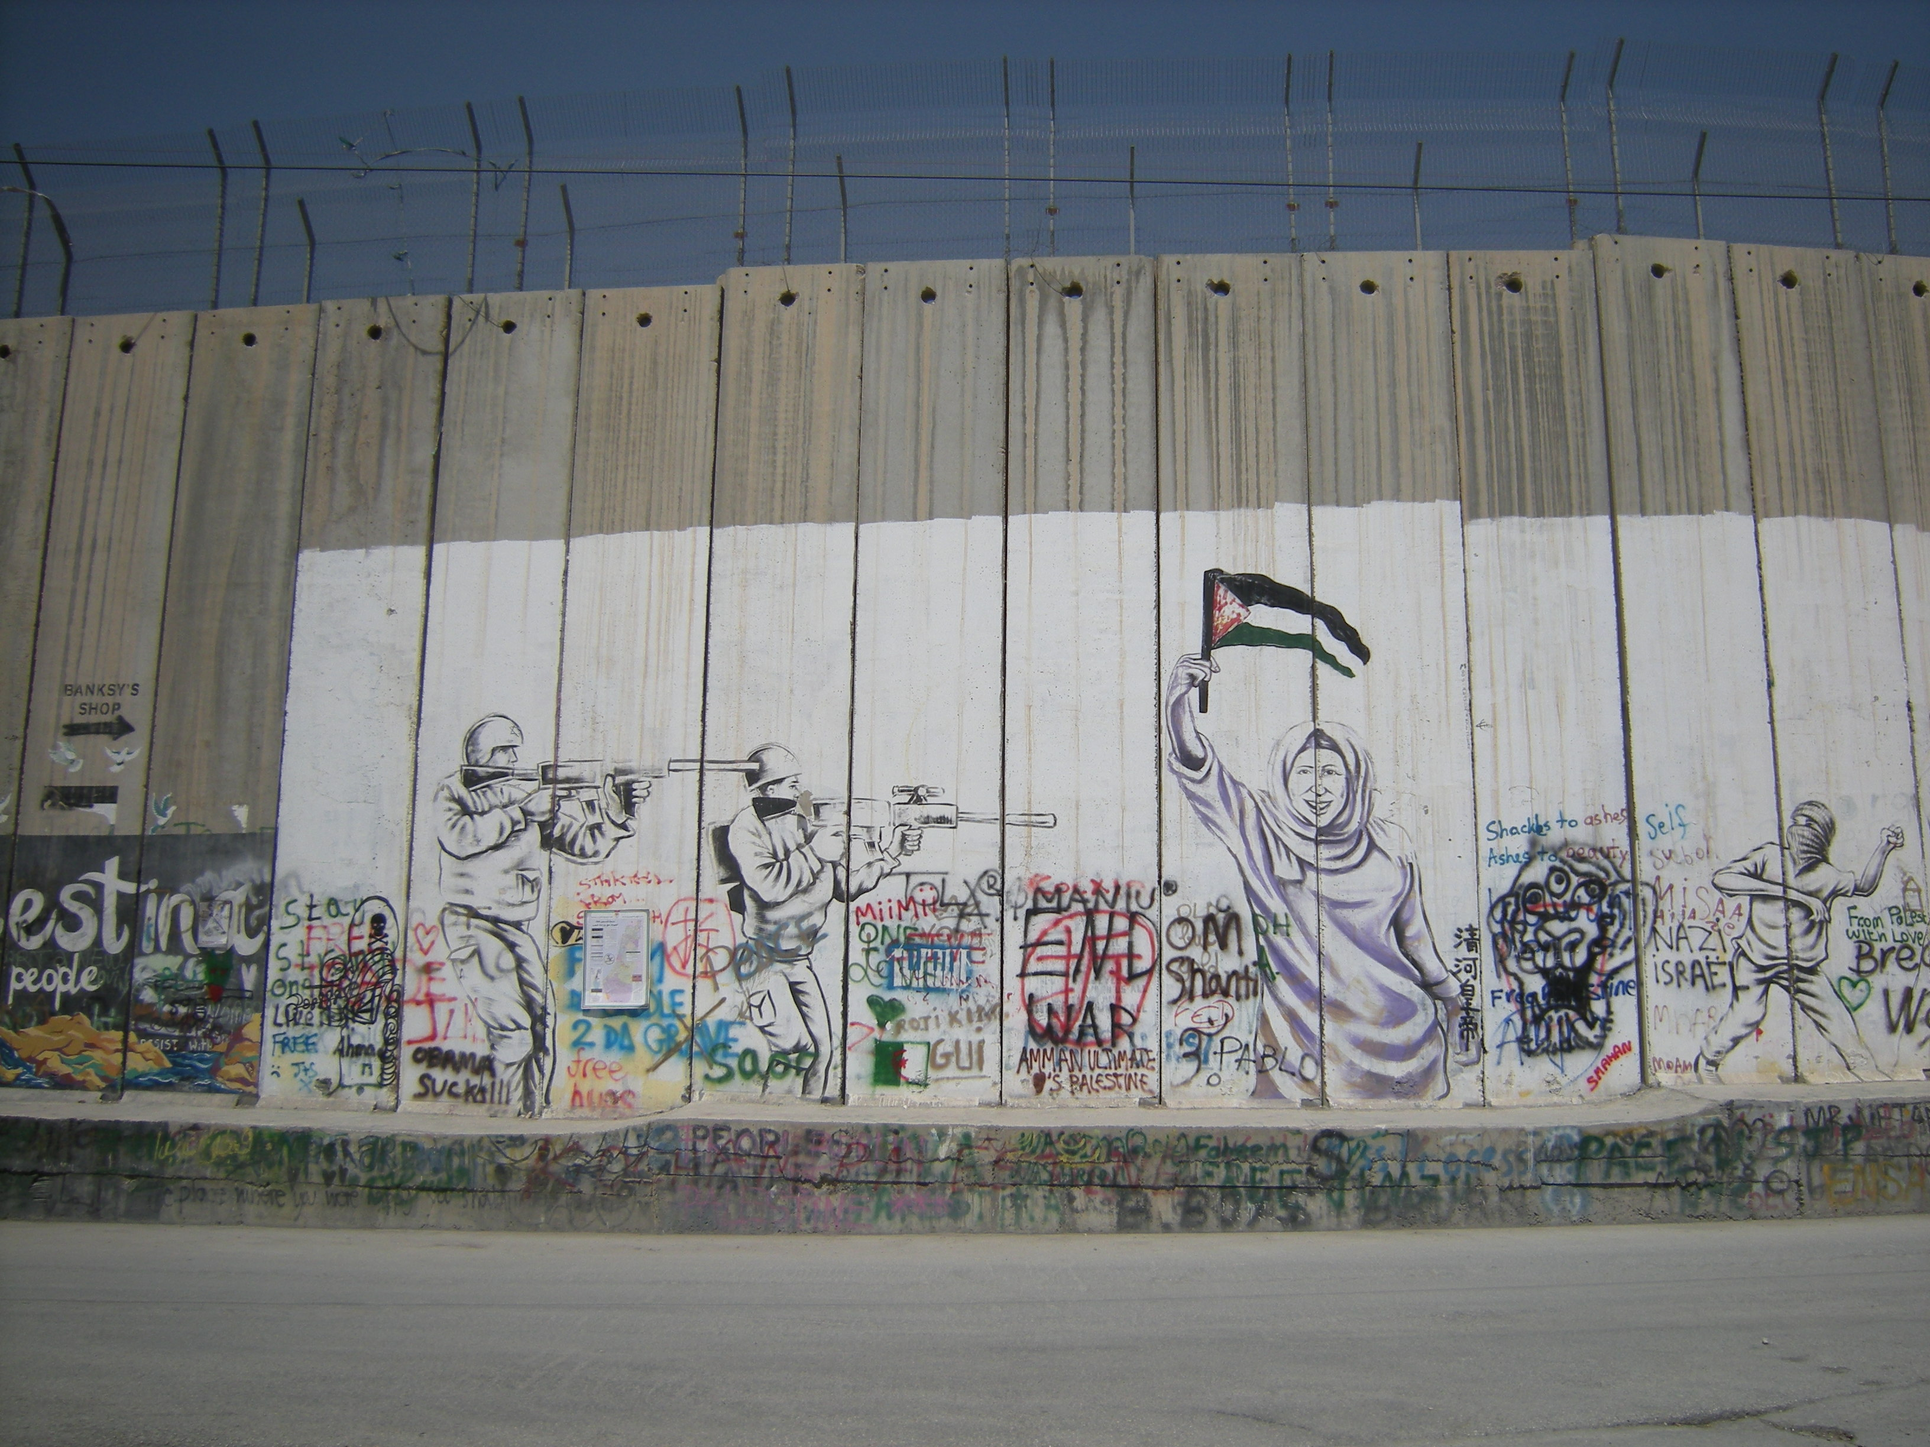
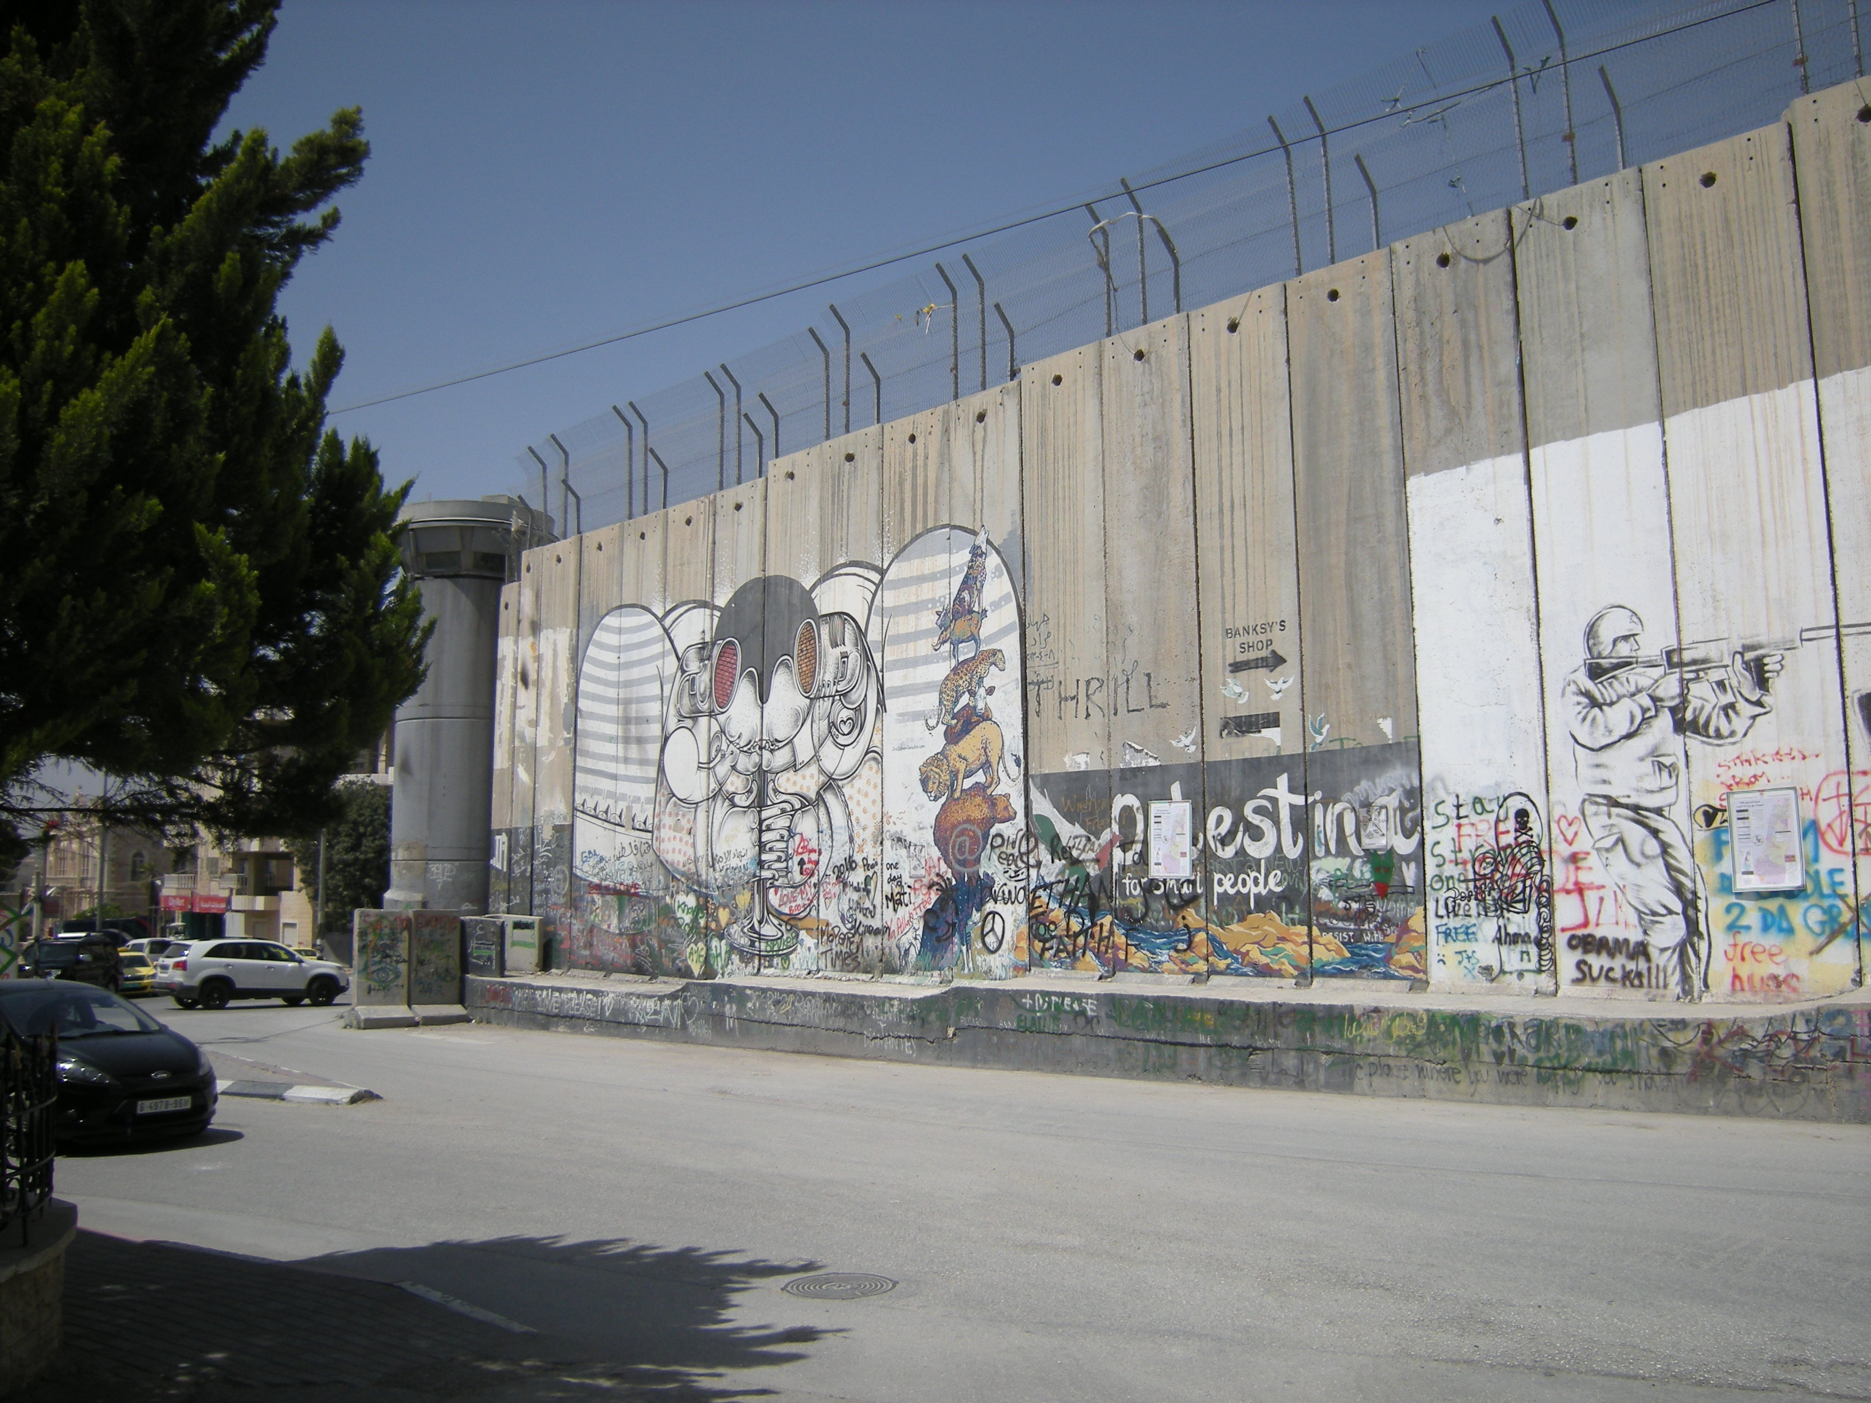
Jerusalem and the wall

Slide 7
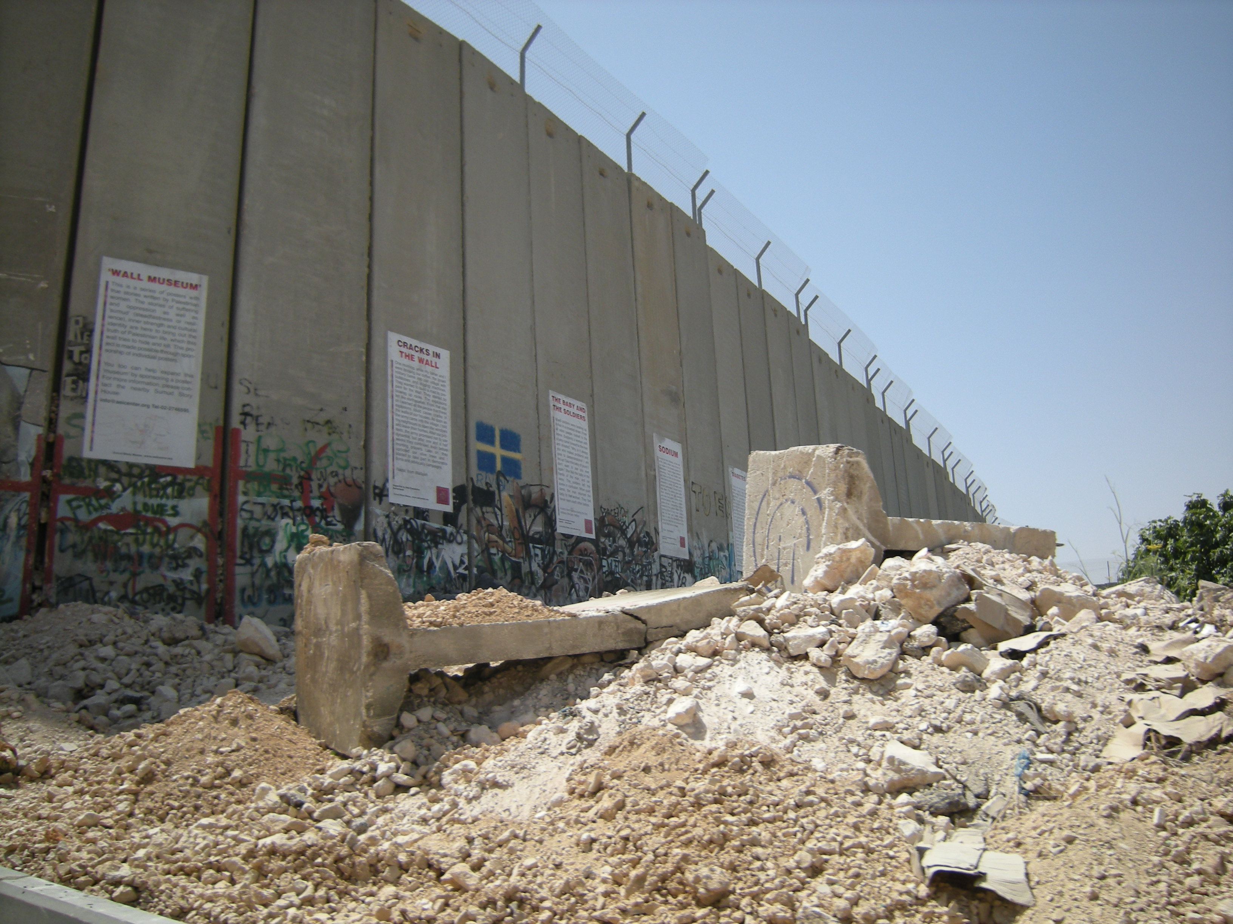
Jerusalem and the wall

Slide 8
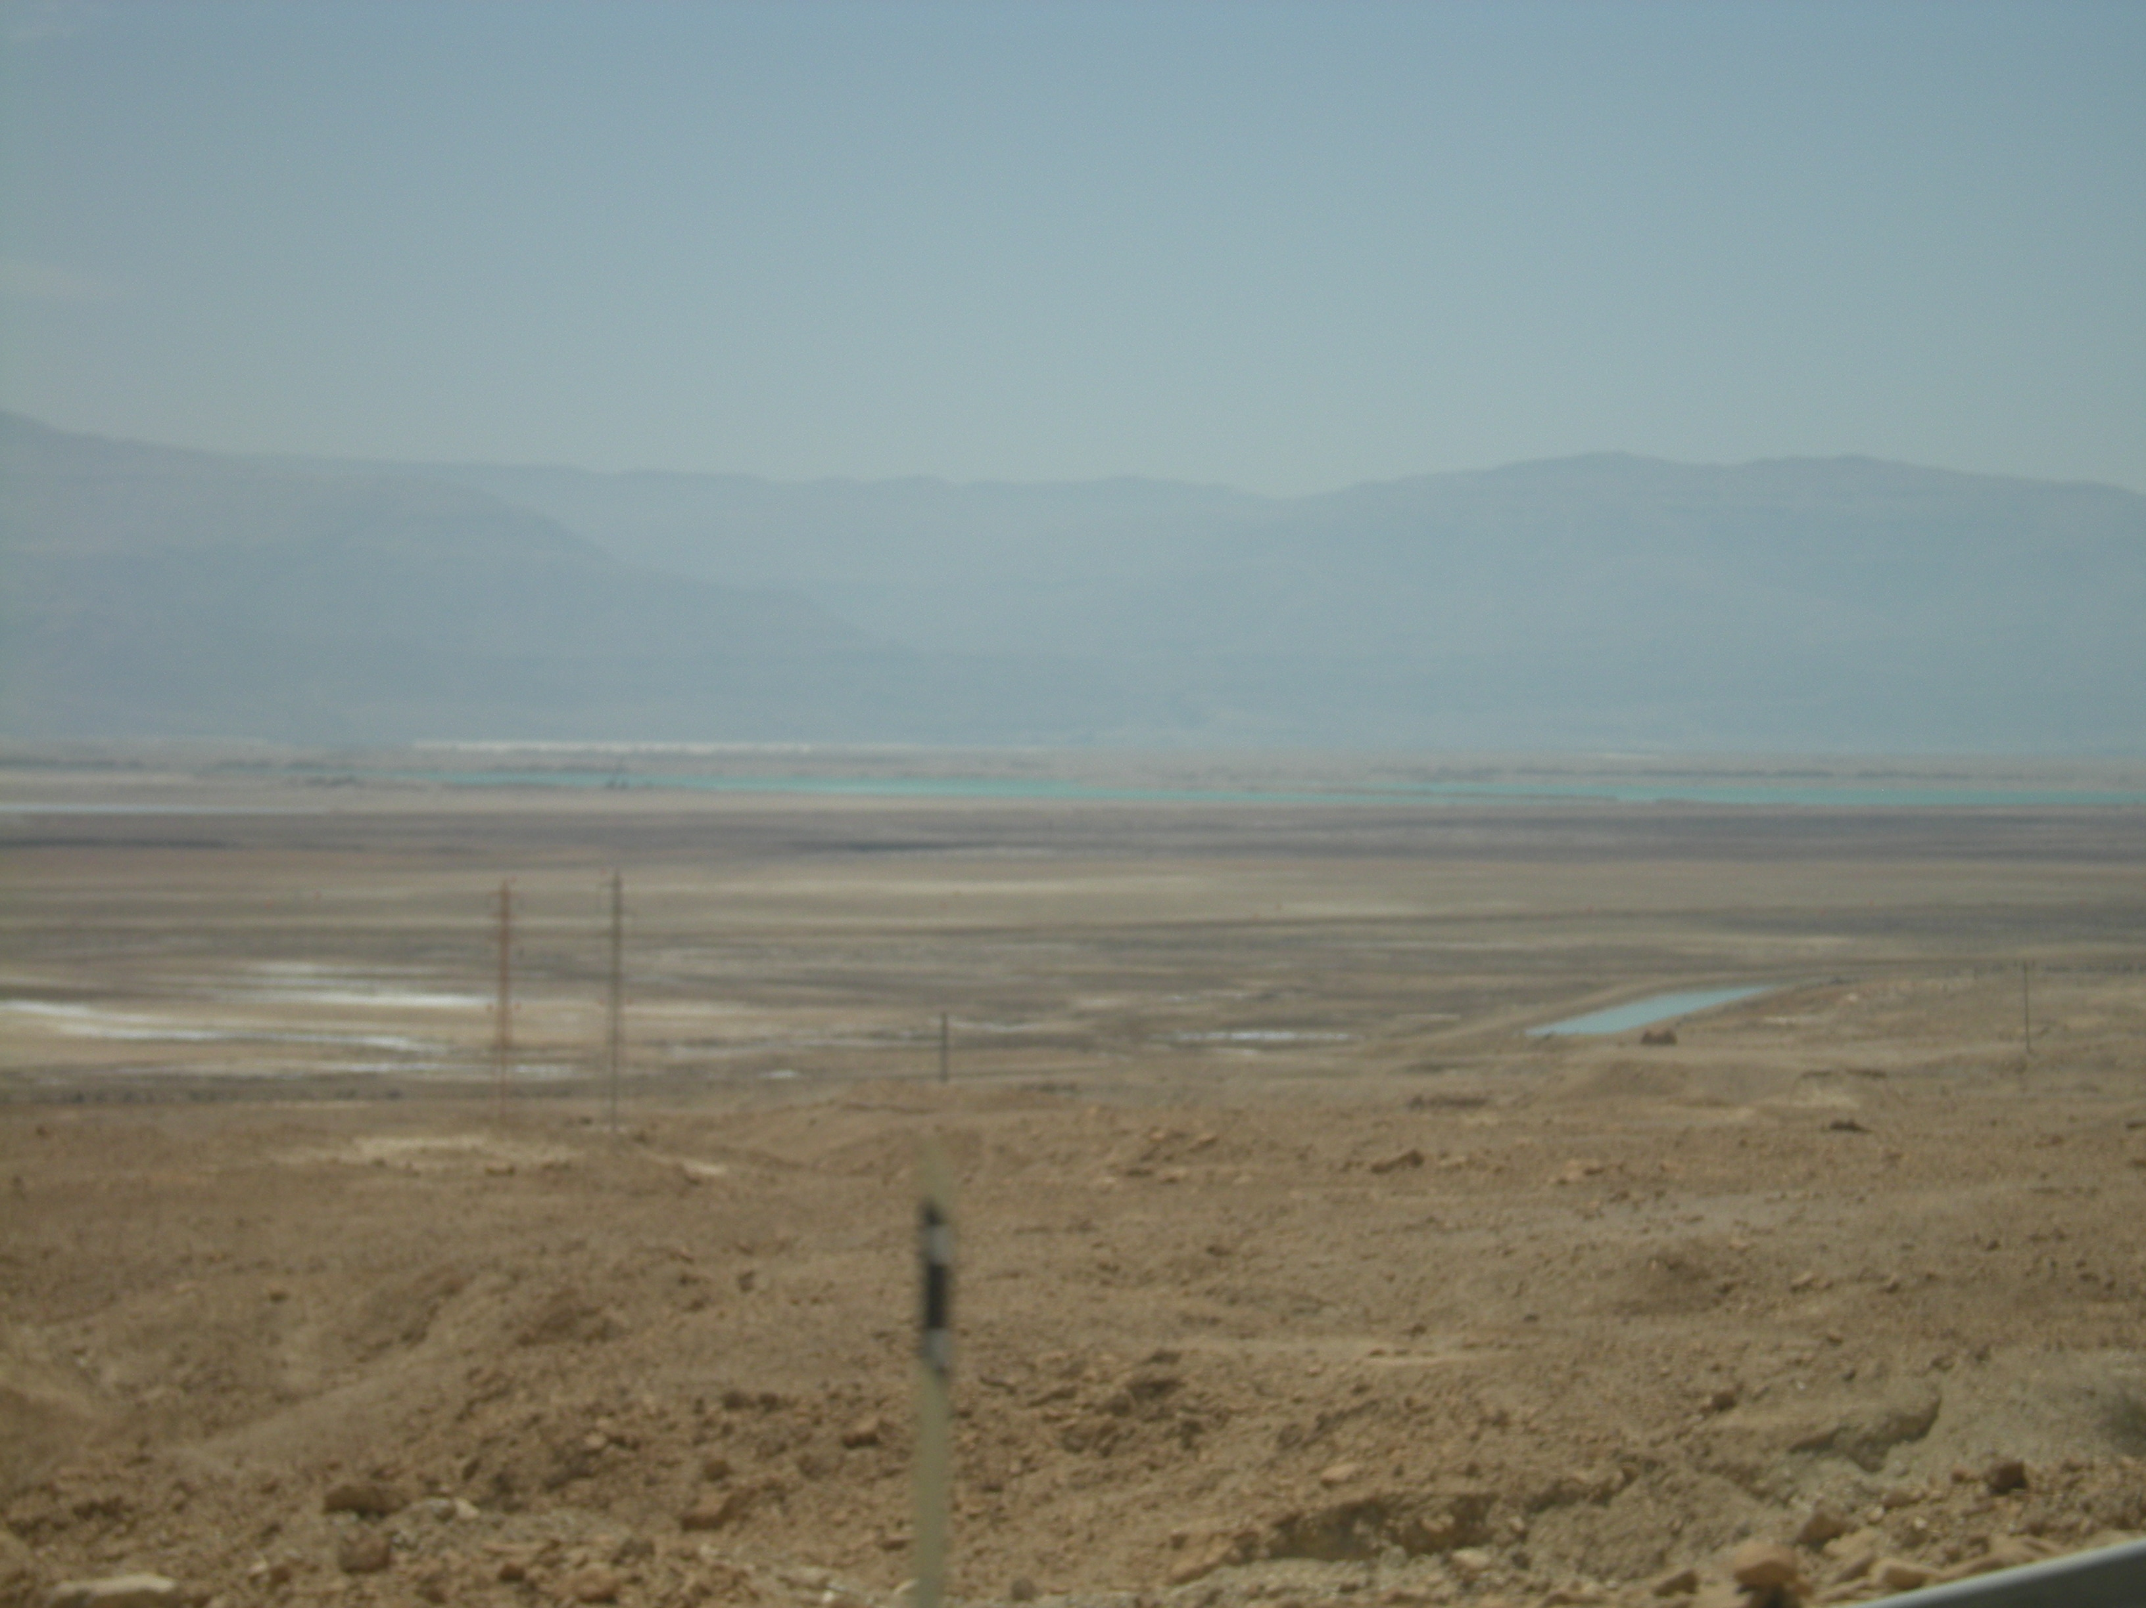
Dead Sea- lives up to its name

