Slide 1
Israel Through Palestinian eyes Pt 4
By Bro. Jared Keyes

Slide 2
History shows that the Arabs entered the land mainly after the inception of the Belfour declaration.
False Statements made that declare the history of Palestinians:
Mohammad Al-Habash -is a Syrian Islamic scholar, writer and politician. He is the principal figure of the Islamic revivalist movement in Syria
Mohammad Hussein-
Grand Mufti (overseer)of the Temple mount for the Palestinians

Slide 3
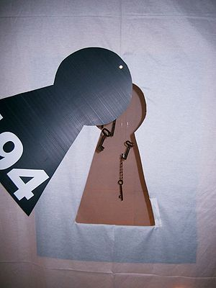
Important details about Palestine and Palestinians
Why was Hezbollah born?
The Palestinian refugees have no Home
Now they have had children and their children have had children etc
Many refugees went North to Lebanon waiting for the moment to come back
Lebanon would not recognize them
They live in Poverty
They cannot travel
They cannot Vote
They have Poor sanitary conditions
This artwork is entitled Resolution 194, a UN resolution. The keys symbolize those kept as mementos by many Palestinians who left their homes in 1948. Such keys and the Handala are common Palestinian symbols of support for the right of return.

Slide 4
What would solve this conflict – from Palestinian POV
Libertate the west bank
Israel to relinquish the West bank totally and a Palestine state needs to be recognized
Israel Settlements to be retracted because they are encroaching and in some cases are on physical Palestinian land
Stop controlling the water
Stop controlling the air space
Stop controlling the rivers/sea
Give the refuges (those without a passport) a chance to decide to come home and give them citizenship. (Palestinians who fled their homes in 1948, 1967, 1973.)
Walls to come down

Slide 5
Summary of why the Palestinians are not from the holy land
Who are the Palestinians -An Arab invention

Slide 6
Palestinian myths
Palestinians do not pay taxes to Israel
This is not true – they pay taxes to the local government as required. Things like water, gas and other resources – taxes are paid when the goods are received
Palestinians don’t pay Israel for resources
They are a burden to Israel
This is not true. Most resources are paid to the local governments and Israel. Most companies are privately owned and governed by the laws of Israel. Therefore the water would be shut off just like in any other country if the person/people were not to pay.

Slide 7
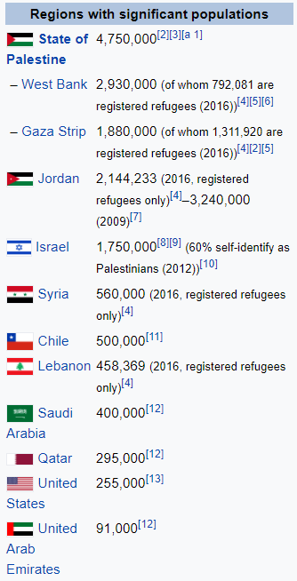
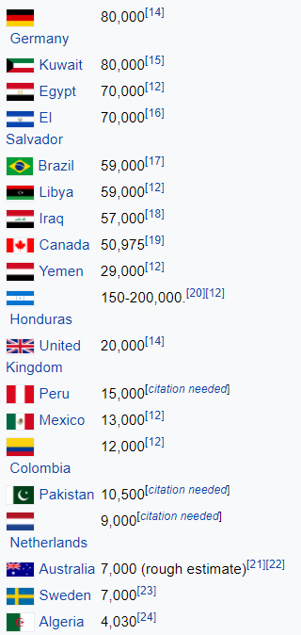
Palestinian Populations

Slide 8
Questions?

