Slide 1
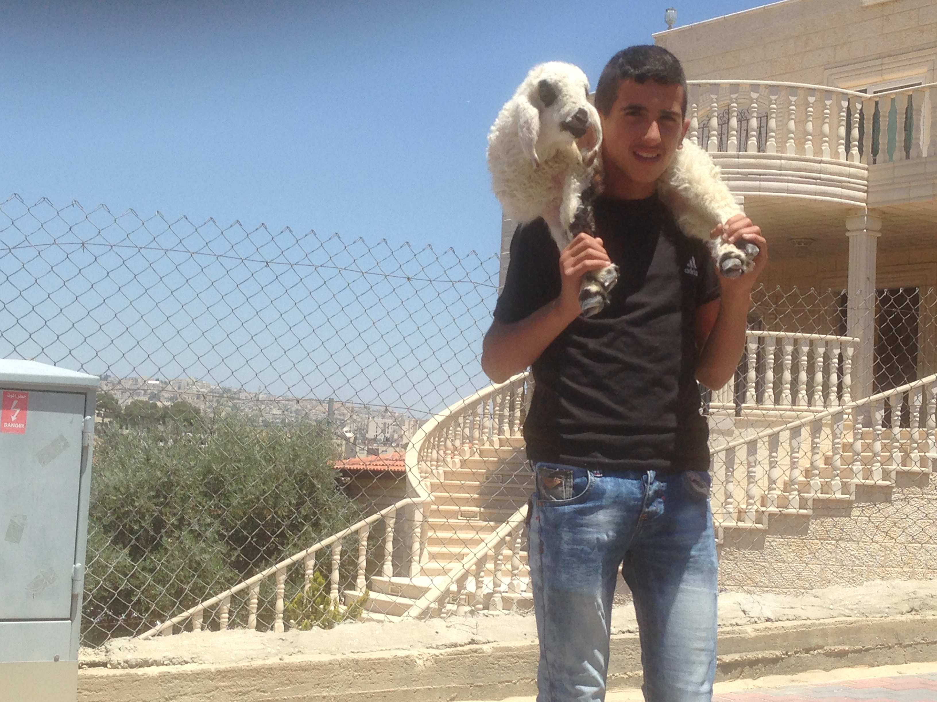
Israel Through Palestinian eyes Pt 3
By Bro. Jared Keyes

Slide 2
Jerusalem the fought over city
Trump recognizes Jerusalem as the capital of the Jewish people and Israel
http://www.cnn.com/videos/politics/2017/12/06/trump-Jerusalem-announcement-sot.cnn/video/playlists/donald-trump--israel/
Arab leaders rebuke Trumps declaration
http://www.cnn.com/videos/world/2017/12/07/trump-jerusalem-decision-safadi-intv.cnn
West Bank erupts in violence in reaction to Trumps decision to recongnize Jerusalem as the capital of Israel.
http://video.foxnews.com/v/5672316824001/#sp=show-clips

Slide 3
Important details about Palestine and Palestinians
There is no language known as Palestinian, or any Palestinian culture distinct from that of all the Arabs in the area. There has never been a land known as Palestine governed by Palestinians. "Palestinians" are Arabs indistinguishable from Arabs throughout the Middle East.
In 1922 Britain allocated nearly 80% of Palestine to Transjordan. Thus, Jordan covers the majority of the land of Palestine under British Mandate. Jordan also includes the majority of the Arabs who lived there. In other words, Jordan is the Arab portion of Palestine.
The residents of Palestine are called "Palestinians". Since Palestine includes both modern day Israel and Jordan both Arab and Jewish residents of this area were referred to as "Palestinians".

Slide 4
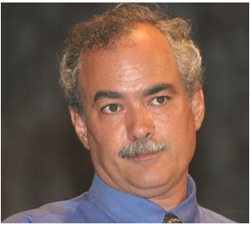
Who are the Palestinians then?
Jordanian flag vs Palestinian flag
“Why is it that on June 4th 1967 I was a Jordanian and overnight I became a Palestinian?” “We did not particularly mind Jordanian rule. The teaching of the destruction of Israel was a definite part of the curriculum, but we considered ourselves Jordanian until the Jews returned to Jerusalem. Then all of the sudden we were Palestinians - they removed the star from the Jordanian flag and all at once we had a Palestinian flag”. “When I finally realized the lies and myths I was taught, it is my duty as a righteous person to speak out”.
Walid Shoebat, a former PLO terrorist
Walid Shoebat, a former PLO terrorist

Slide 5
Who are the Palestinians then?
Abraham – Sarah - Haggar
Gen 25V23
Isaac
Ishmael
Given the land
From Havilah to Shur
(Egypt)
Gen 17v20-21
Gen 25V12-18
1 Sam 15V7
Jacob
Esau
Blessing:
Dew of heaven
Fatness of the land
Plenty of grain + wine
People will serve him
Nations will Bow
Be Lord to his brothers
Mothers sons will bow down to him
Blessing: Gen 27V39-40
Away from the fatness of the earth shall his dwelling be
Away from the dew
Live by the sword
serve brothers
Nations will Bow
No longer be yoked to his brothers

Slide 6
Who are the Palestinians then?
The Palestinians want the land
They refuse to admit to the Jews being God’s chosen people
The Palestinian Christians believe they inherited the land but no where in scripture is it mentioned
They recognize they are not part of Jacob
So they focus on who was living in the land and who are the property owners from about the last 100years.

Slide 7
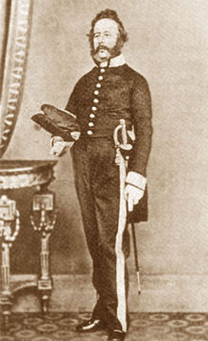
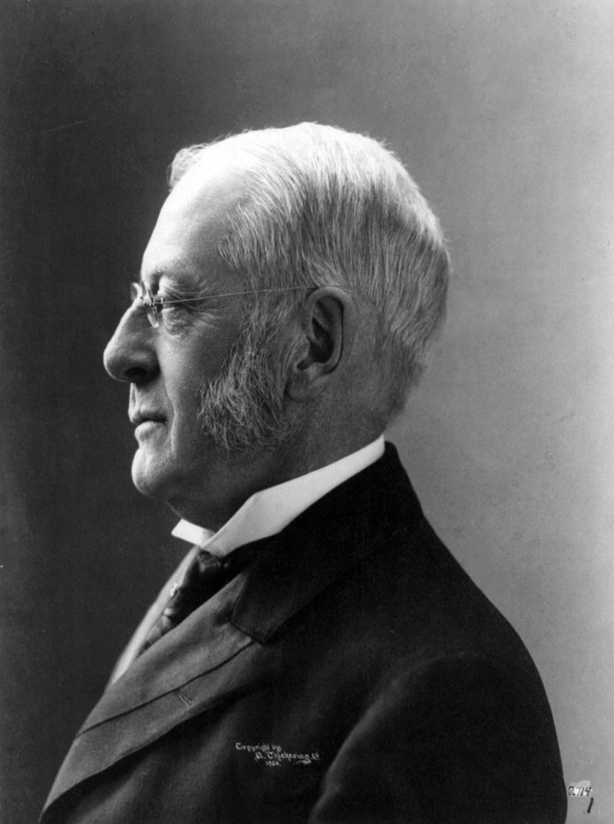
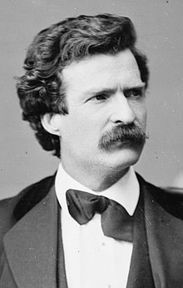
Palestinian history does not line up with actual history
James Finn – the British council reported in 1867:
“The country is a considerable degree empty of inhabitants and therefore its greatest need is that of a body of population.”
Charles Wyllys Elliott – President of Harvard University wrote in 1867:
“A beautiful sea lies unbosomed, amount the Gentile hills in the mist of the land once possessed by Zebulon an Naphtali Asher and Dan. Life here was once Idyllic(extremely happy) ….now it is a scene of desolation and misery.”
Mark Twain – visited the holy land and had this to say in 1867:
“A desolate country… a mournful expanse… There are two or three small clusters of Bedouin tents but not a single permanent habitation. One may ride ten miles, hereabouts, and not see ten human beings.”

Slide 8
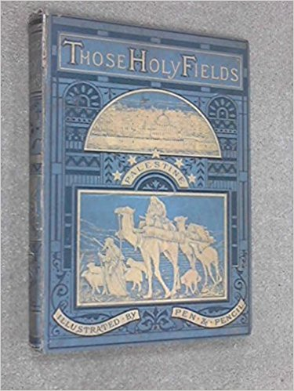
Palestinian history does not line up with actual history
Reverend Samuel Manning wrote:
“Day by day we were to learn afresh the lessons now upon us, that the denunciations of ancient prophesy have been fulfilled to the very letter: “ (These Holy Fields) …”The land is left void and desolate and without inhabitants.” Jer Ch 44v 22

Slide 9
History shows that the Arabs entered the land mainly after the inception of the Belfour declaration.
Britain during its mandate over the territory turned a blind eye to the flood of illegal Arab aliens entering while at the same time limiting Jewish immigration in the ancient , biblical and ancestral homeland.
The British Hope-Simpson Commission recommended in 1930,
“Prevention of illicit immigration” to stop the illegal Arab immigration.
The Governor of the district of Hauran, Tewfik Bey El Hurani, admitted in 1934 that a single period of only a few months over 30,000 Syrians from Hauran had moved to Palestine.
Franklin D. Roosevelt – May 17,1937 –
“the Arab immigration to Palestine since 1921 was much greater than Jewish immigration.”

Slide 10
History shows that the Arabs entered the land mainly after the inception of the Belfour declaration.
British Prime Minister – Winston Churchill noted in1939 regarding Arabs in Palestine,
“The Arabs have crowed into the country and multiplied till their population has increased more than even all world Jewry could lift up the Jewish population.”

Slide 11
Questions?

