Slide 1
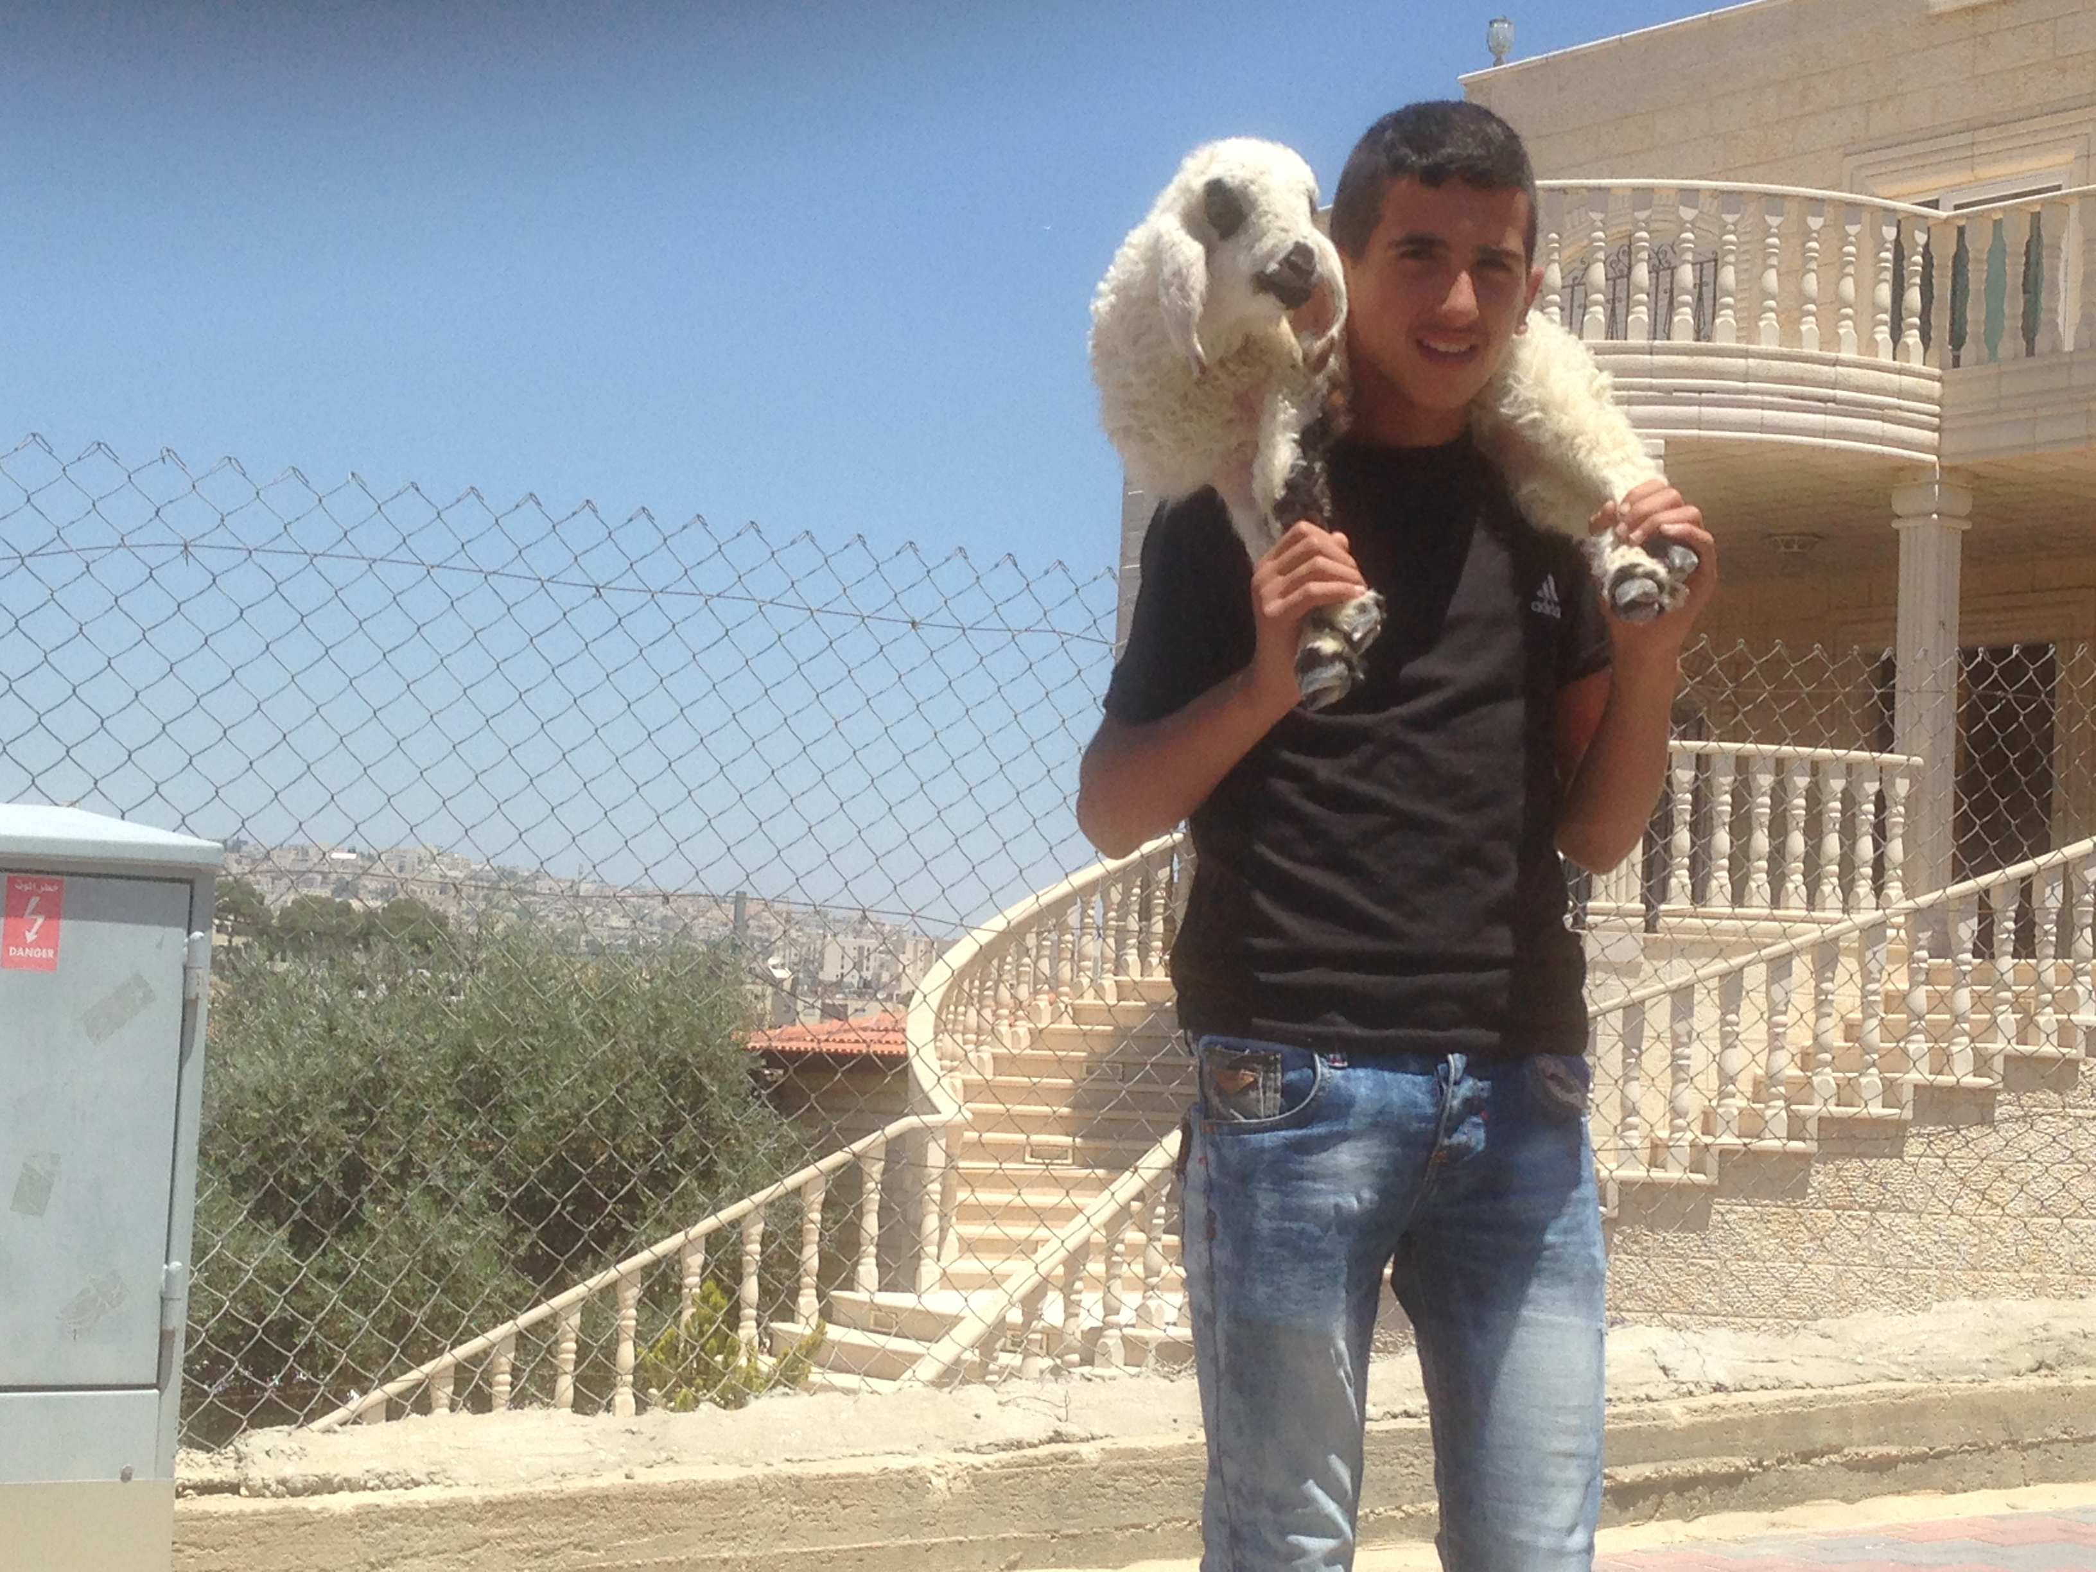
Israel Through Palestinian eyes Pt 2
By Bro. Jared Keyes

Slide 2
Words to remember
Mohammed – Creator of the Islam religion – Was to become a great nation after the line of Ishmeael
Gen 21:18
Kaaba – means cube
A black stone believed to be a meteorite that fell from heaven! It was worshiped by the arabs, they collected it and built this shrine around it.
Mecca – a follower must return there once in his lifetime
Hijra – is now the pilgrimage every Muslim must make back to Mecca once in their lifetime at least
Muslim – submitter – Arabic for Islam
Ramadan –Established after the battle of Badyr with unbelievable odds 300 vs 900. It is a fast
Caliph- is Ruler and leader who followed after the order of Mohammed
Shite or Shias - Believed that you must be a direct descendant of Mohammad in order to be a ruler (Caliph)
Sunnis - believe that you must be appointed by someone from Mohammed's tribe in order to be a Caliph

Slide 3
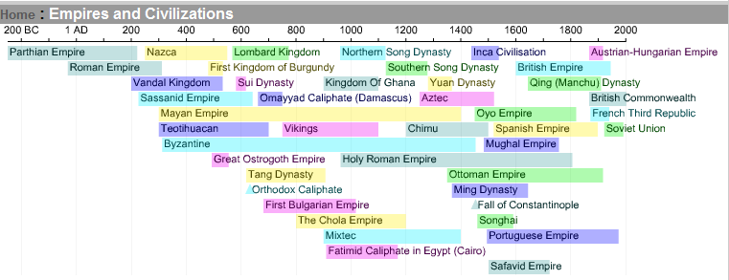
Timeline
We discussed heavily the time during the end of the Roman empire to the middle of the Byzantine empire
We are now going to look at the end of the Ottoman empire to see where these Arabs and Muslims ended up and how they play a role in the Land of Israel

Slide 4
The Area of Palestine

Slide 5
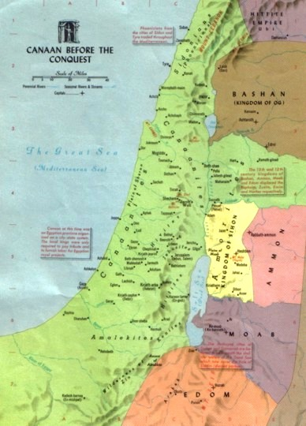
The Jews –God chosen people
Land of Cannon Gen 11:31
Given to Abraham and his seed forever as an inheritance. Gen 12:1
Israel is called Gods chosen people Deut 7:6, 14:2, Ps 33:12,

Slide 6
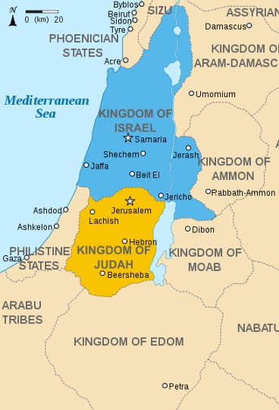
Israel and the land
Always been at war with some group and unsettled
The land was split up before – they became two
nations during the reign of King Jeroboam
Jerusalem destroyed in AD70
Jews would be scattered Eze 6:8, 11:16
Jews would be gathered together to return to the land

Slide 7
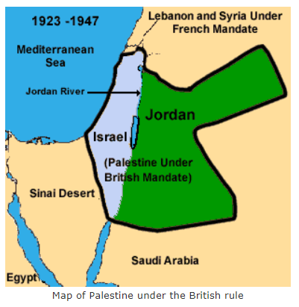
The land and the history
Palestine was made up of
Both Israel and modern
day Jordon
Was under the ottoman empire
Until 1917 when the Balfour declaration
was established making Palestine a
home for the Jews

Slide 8
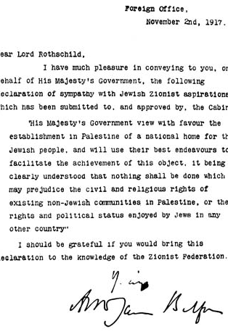
What was the Balfour declaration of 1917?
Although the document allocated for a Jewish state it really was only worth the paper it was written on.
Notice the phase “…view with favor”
Lord Balfour was a Protestant Christian and this made it easy for him to see the importance of a Jewish presence in Palestine.
Anti Semitism within the Governement actually helped to get this passed.
The British felt if they kept control of Palestine but gave some Zionist freedom to return to Palestine they would somehow keep control the Zionist movement.
http://www.aljazeera.com/indepth/features/2017/10/100-years-balfour-declaration-explained-171028055805843.html

Slide 9
Key words to know
Military occupation - is effective provisional control by a certain ruling power over a territory which is not under the formal sovereignty of that entity, without the volition of the actual sovereign.
01
Occupied Territories -under the authority and effective control of a belligerent armed force. The term is not applicable to territory being administered pursuant to peace terms, treaty, or other agreement, express or implied, with the civil authority of the territory.
02
Intifada (1 and 2) -the Palestinian uprising against Israeli occupation of the West Bank and Gaza Strip, beginning in 1987.
03

Slide 10
Religions in Israel
The overwhelming majority of Palestinians are Muslims. Almost the entire Palestinian Muslim population is Sunni, although few dozen converts to Ahmadiyya Islam resides in West Bank. According to Palestinian constitution, article 4: "Islam is the official religion of Palestine. Respect for the sanctity of all other divine religions shall be maintained".
74.8% Jewish
17.6% Muslim
2% Christian
1.6% Druze
4% other

Slide 11
1917-1947 British mandate split into Palestine and Transjordan
Jews moved to Israel in droves – due to Hitler rule etc.
Anything east of the Jordon is Transjordan
Anything west of the Jordan is Palestine divided between the Jews and Arabs

Slide 12
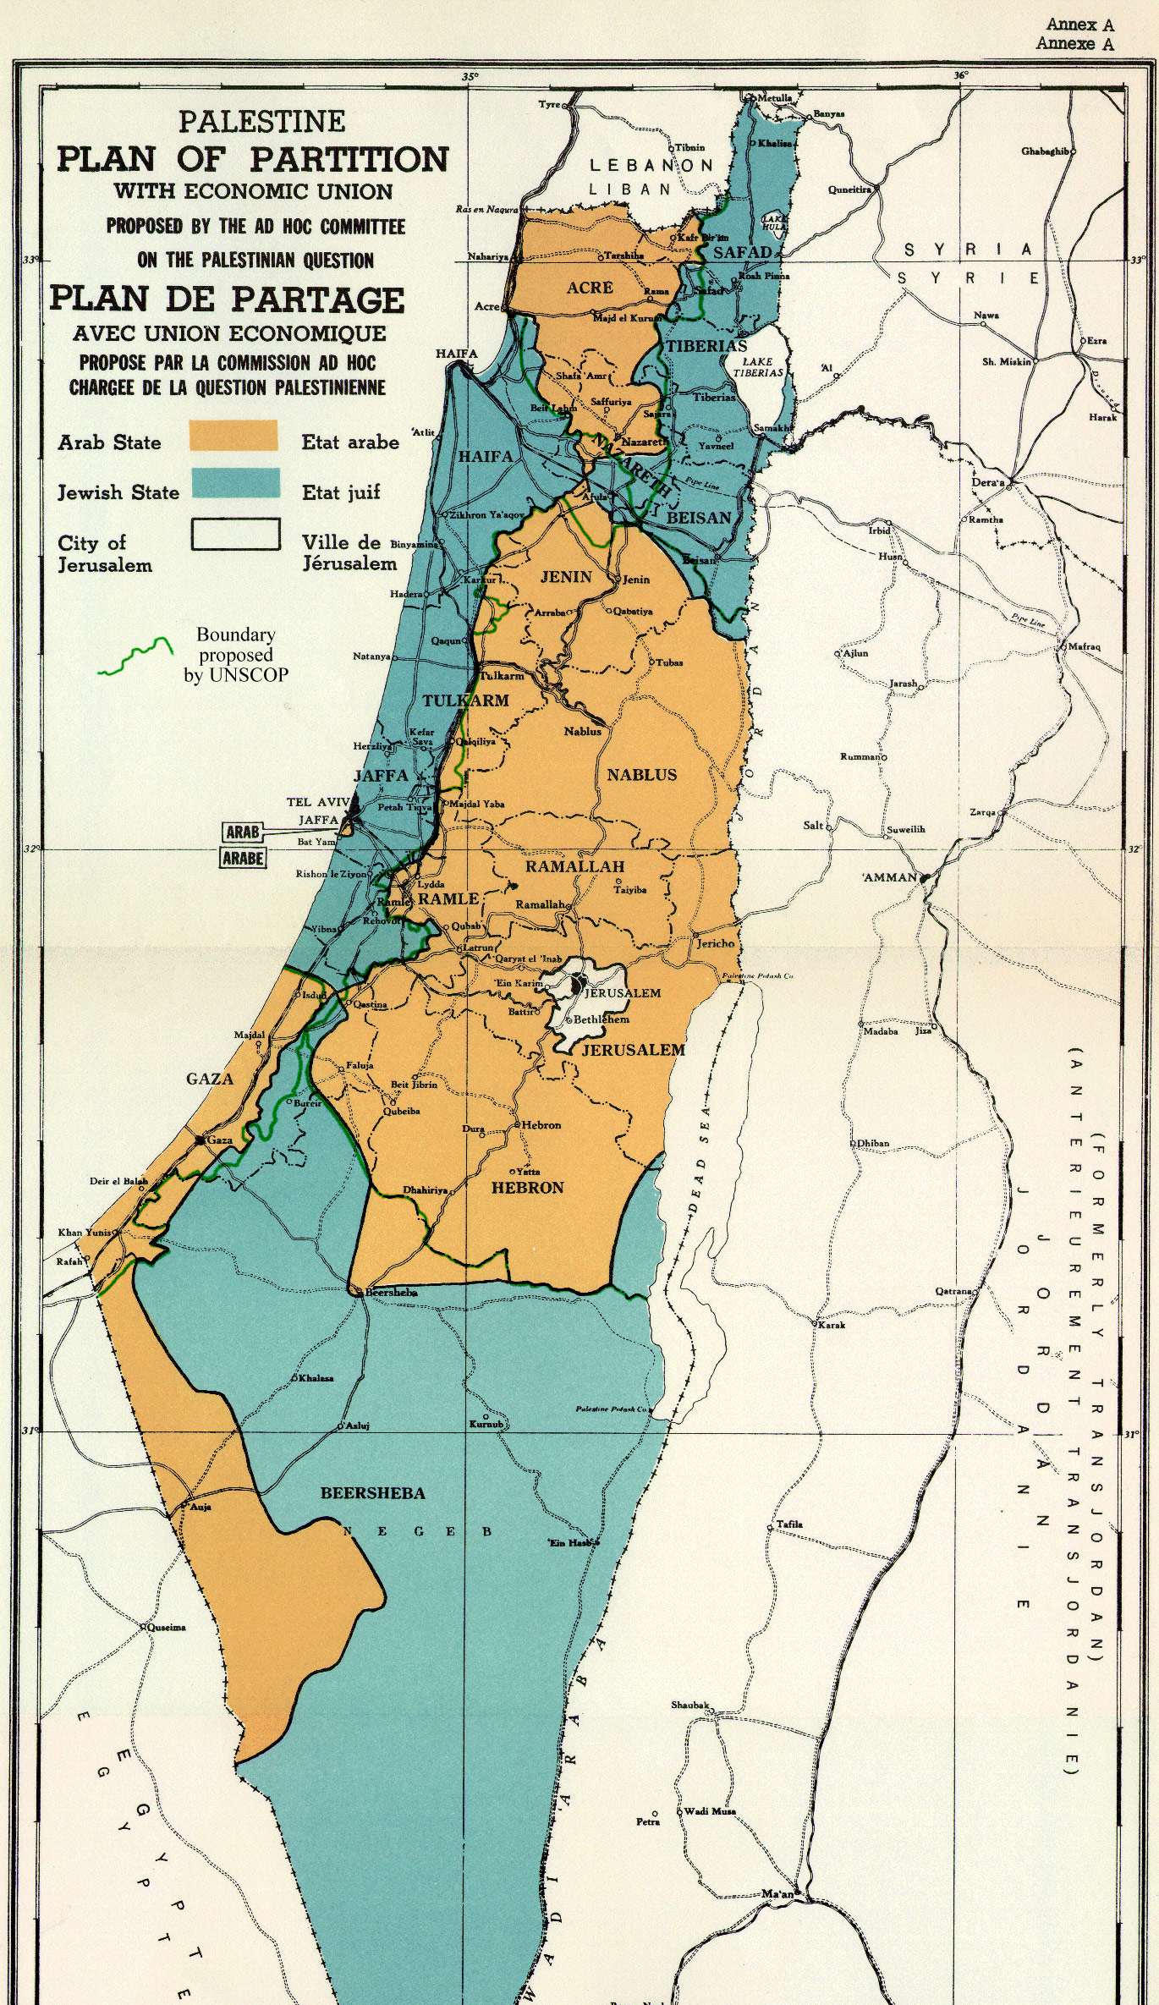
UN resolution 181- United Nation partition plan
The United Nations Partition Plan for Palestine was a proposal by the United Nations, which recommended a partition of Mandatory Palestine at the end of the British Mandate. On 29 November 1947, the UN General Assembly adopted the Plan as Resolution 181 – celebrating 70years a nation.
the United Nations declared to the modern world an ancient truth, that the Jewish people have a natural, irrevocable right to an independent state in their ancestral and eternal homeland.
http://www.jewishpress.com/blogs/guest-blog/watch-vp-mike-pences-amazing-speech-destroyed-palestinian-claims/2017/12/03/
Theoretical division of the land
Israel had no formal military
All the nations around them came in to fight and invade them
Jordan
Syria
Egypt
Israel won the war – some territories are gained
As a result of the war the State of Israel controlled both the area that the UN General Assembly Resolution 181 had recommended for the proposed Jewish state as well as almost 60% of the area of Arab state proposed by the 1948 Partition Plan including the Jaffa, Lydda and Ramle area, Galilee, some parts of the Negev, a wide strip along the Tel-Aviv-Jerusalem road, West Jerusalem, and some territories in the West Bank. Transjordan took control of the remainder of the former British mandate, which it annexed, and the Egyptian military took control of the Gaza Strip. At the Jericho Conference on 1 December 1948, 2,000 Palestinian delegates called for unification of Palestine and Transjordan as a step toward full Arab unity." No state was created for the Palestinian Arabs.

Slide 13
1948 – Israel becomes a nation
Prophesy becomes reality- Israel is restored - Isa 49V6
And he said, It is a light thing that thou shouldest be my servant to raise up the tribes of Jacob, and to restore the preserved of Israel: I will also give thee for a light to the Gentiles, that thou mayest be my salvation unto the end of the earth.
Christadelphians have been waiting for this day as a sign that Jesus will return soon:
“…this generation shall not pass away” until he comes
Matt 24:34
Depending on the sources and the definition, between 10 and 70 massacres occurred during the 1948 war.

Slide 14
Killings and massacres during the 1948 Palestine war
Depending on the sources and the definition, between 10 and 70 massacres occurred during the 1948 war.
Haifa Oil Refinery massacre – 39 Israelis killed
Kfar Etzion massacre 120- Israelis killed
Palestinian massacres
Deir Yassin massacre -112 Arabs killed
Saliha massacre - 60-70 Arabs killed
Lydda massacre – 250 Arabs killed
Abu Shusha massacre – 60-70 Arabs killed
David Ben-Gurion gave the figure of 70-80.

Slide 15
UN resolution 194
United Nations General Assembly Resolution 194 was adopted on December 11, 1948, near the end of the 1948 Arab–Israeli War. The Resolution defined principles for reaching a final settlement and returning Palestine refugees to their homes. It resolved that “refugees wishing to return to their homes and live at peace with their neighbors should be permitted to do so at the earliest practicable date, and that compensation should be paid for the property of those choosing not to return and for loss of or damage to property which, under principles of international law or equity, should be made good by the Governments or authorities responsible.” (Article 11)

Slide 16
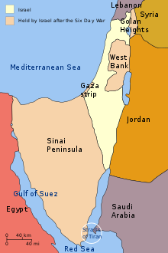
1967 – The six day War
Fought between June 5 and 10, 1967 by Israel
and the neighboring states of Egypt
(known at the time as the United Arab Republic)
, Jordan, and Syria.
Straights of Tiran was closed by Egypt
Israel took out Egypt's air fighters leaving them
defenseless
Abdel Nasser induced Northern Syria and Jordan to
begin attacks on Israel by using the initially confused
situation to claim that Egypt had defeated the Israeli
air strike.
Israeli counterattacks resulted in the seizure
of East Jerusalem as well as the West Bank from the
Jordanians, while Israel's retaliation against Syria resulted
in its occupation of the Golan Heights.

Slide 17
How was the land split up?
UN still called west bank and Gaza
As occupied land

Slide 18
Israel building settlements surrounding Palestinian villages in the west bank
For some reason – Arabs and Jews culturally have issues with boundaries. See fence on my neighbors property- how it jogs. This was a dipute btw both property owners. Perhaps poor record keeping??

Slide 19
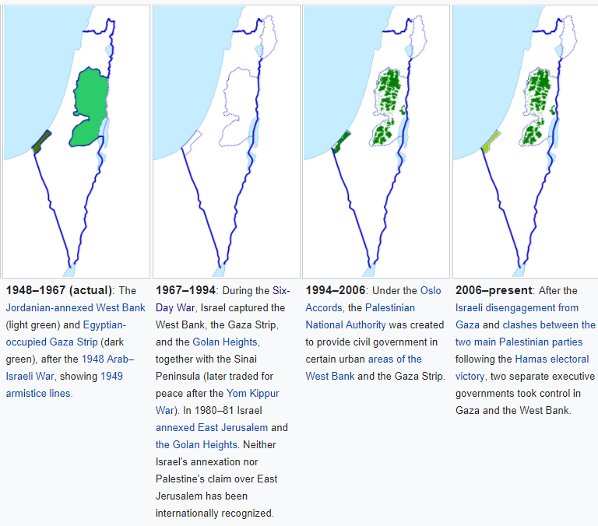
How was the land split up?

Slide 20
How was the land split up?

Slide 21
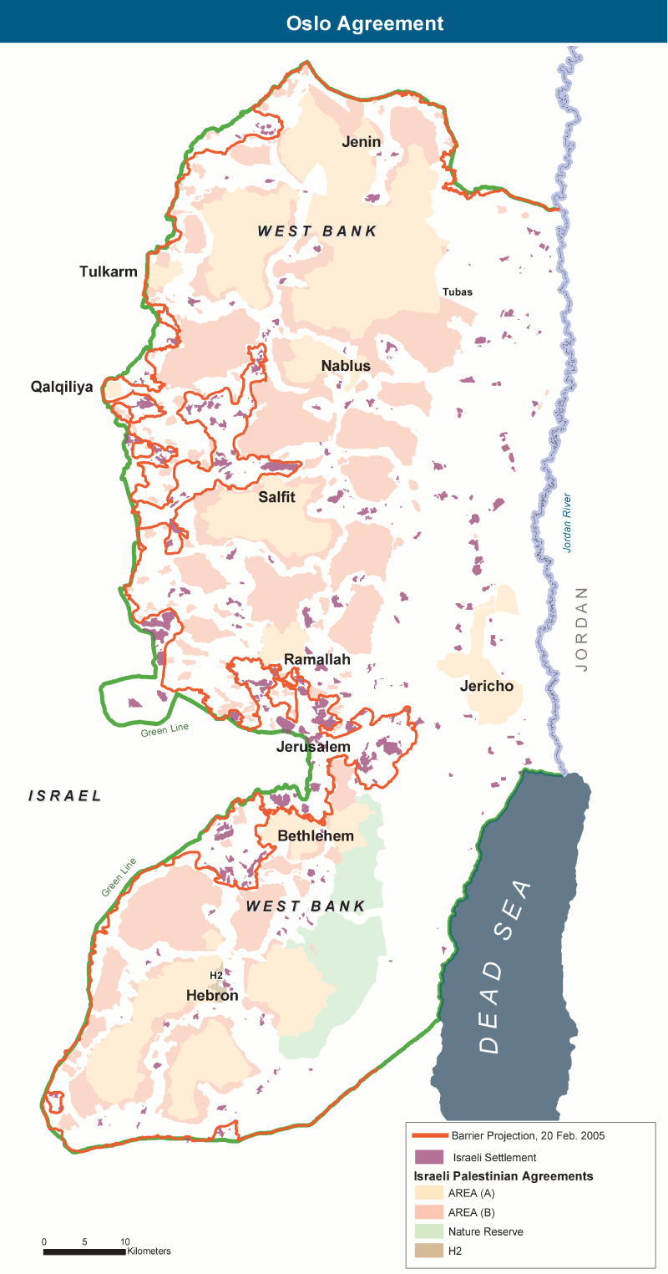
How was the land split up?

Slide 22
The first Intifada 1987-1993
The first Intifada (1987–93) was the first popular uprising against the Israeli occupation of 1967. Followed by the PLO’s (Palestine Liberation Organization).1988 proclamation of a State of Palestine, these developments served to further reinforce the Palestinian national identity. After the Gulf War in 1991, Kuwaiti authorities forcibly pressured nearly 200,000 Palestinians to leave Kuwait. The policy which partly led to this exodus was a response to the alignment of PLO leader Yasser Arafat with Saddam Hussein.

Slide 23
Oslo Accord - 1993
The Accord provided for the creation of a Palestinian interim self-government (not a Palestinane statehood!) called The Palestinian National Authority (PNA). The Palestinian Authority would have responsibility for the administration of the territory under its control. The Accords also called for the withdrawal of the Israel Defense Forces (IDF) from parts of the Gaza Strip and West Bank.
It was anticipated that this arrangement would last for a five-year interim period during which a permanent agreement would be negotiated (beginning no later than May 1996). Remaining issues such as Jerusalem, Palestinian refugees, Israeli settlements, security and borders would be part of the "permanent status negotiations" during this period.

Slide 24
The Second Intifada 2000-2005
The 2nd intifada started in September 2000, when Ariel Sharon made a visit to the Temple Mount, seen by Palestinians as highly provocative; and Palestinian demonstrators, throwing stones at police, were dispersed by the Israeli army, using tear gas and bullets.
Both parties caused high numbers of casualties among civilians as well as combatants: the Palestinians by numerous suicide bombings and gunfire; the Israelis by tank and gunfire and air attacks, by numerous targeted killings, and by reactions to demonstrations. The death toll, including both military and civilian, is estimated to be about 3,000 Palestinians and 1,000 Israelis, as well as 64 foreigners.
Many consider the Sharm el-Sheikh Summit on 8 February 2005 to be the end of the Second Intifada, when President Mahmoud Abbas and Prime Minister Ariel Sharon agreed that all Palestinians would stop all acts of violence against all Israelis everywhere and, in parallel, that Israel would cease all its military activity against all Palestinians everywhere. They reaffirmed their commitment to the Roadmap for Peace which began at Madrid. However, the violence did not stop in the following years, though suicide bombings decreased significantly.

Slide 25
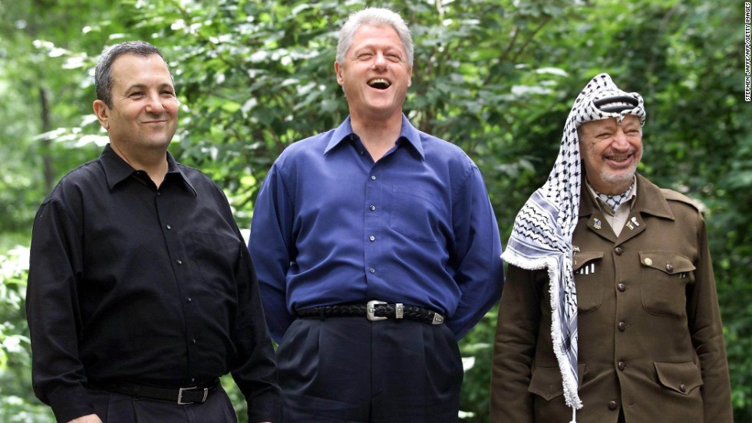
Camp David Summit
Then-Israeli Prime Minister Ehud Barak, left, with the then-President Bill
Camp David Summit
From 11 to 25 July 2000, the Middle East Peace Summit at Camp David was held between United States President Bill Clinton, Israeli Prime Minister Ehud Barak, and Palestinian Authority Chairman Yasser Arafat. The talks ultimately failed with each side blaming the other. There were four principal obstacles to agreement: territory, Jerusalem and the Temple Mount, refugees and the right of return, and Israeli security concerns. Disappointment at the situation over the summer led to a significant fracturing of the PLO as many Fatah factions abandoned it to join Hamas and Islamic Jihad.
On 13 September 2000, Yasser Arafat and the Palestinian Legislative Council postponed the planned unilateral declaration of an independent Palestinian state.

Slide 26
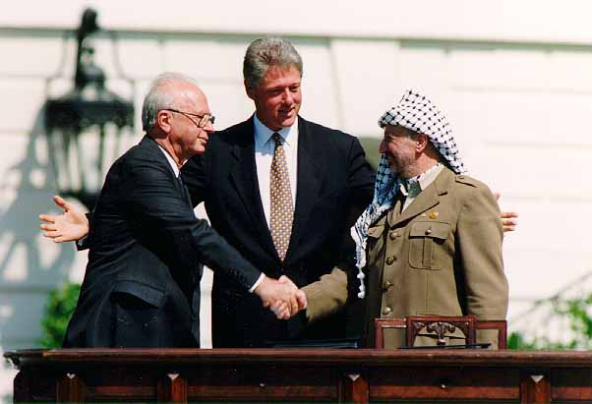
Yasser Arafat – head of the Palestine Liberation Organization (PLO) from 1969 to 2004
Even the Chairman of the Palestinian Authority, Arafat himself, is not a "Palestinian". He was born in Egypt.
Israeli Prime Minister Yitzhak Rabin,
U.S. President Bill Clinton, and Yasser Arafat
at the Oslo Accords signing ceremony on 13 September 1993

Slide 27
Questions?

