Slide 1
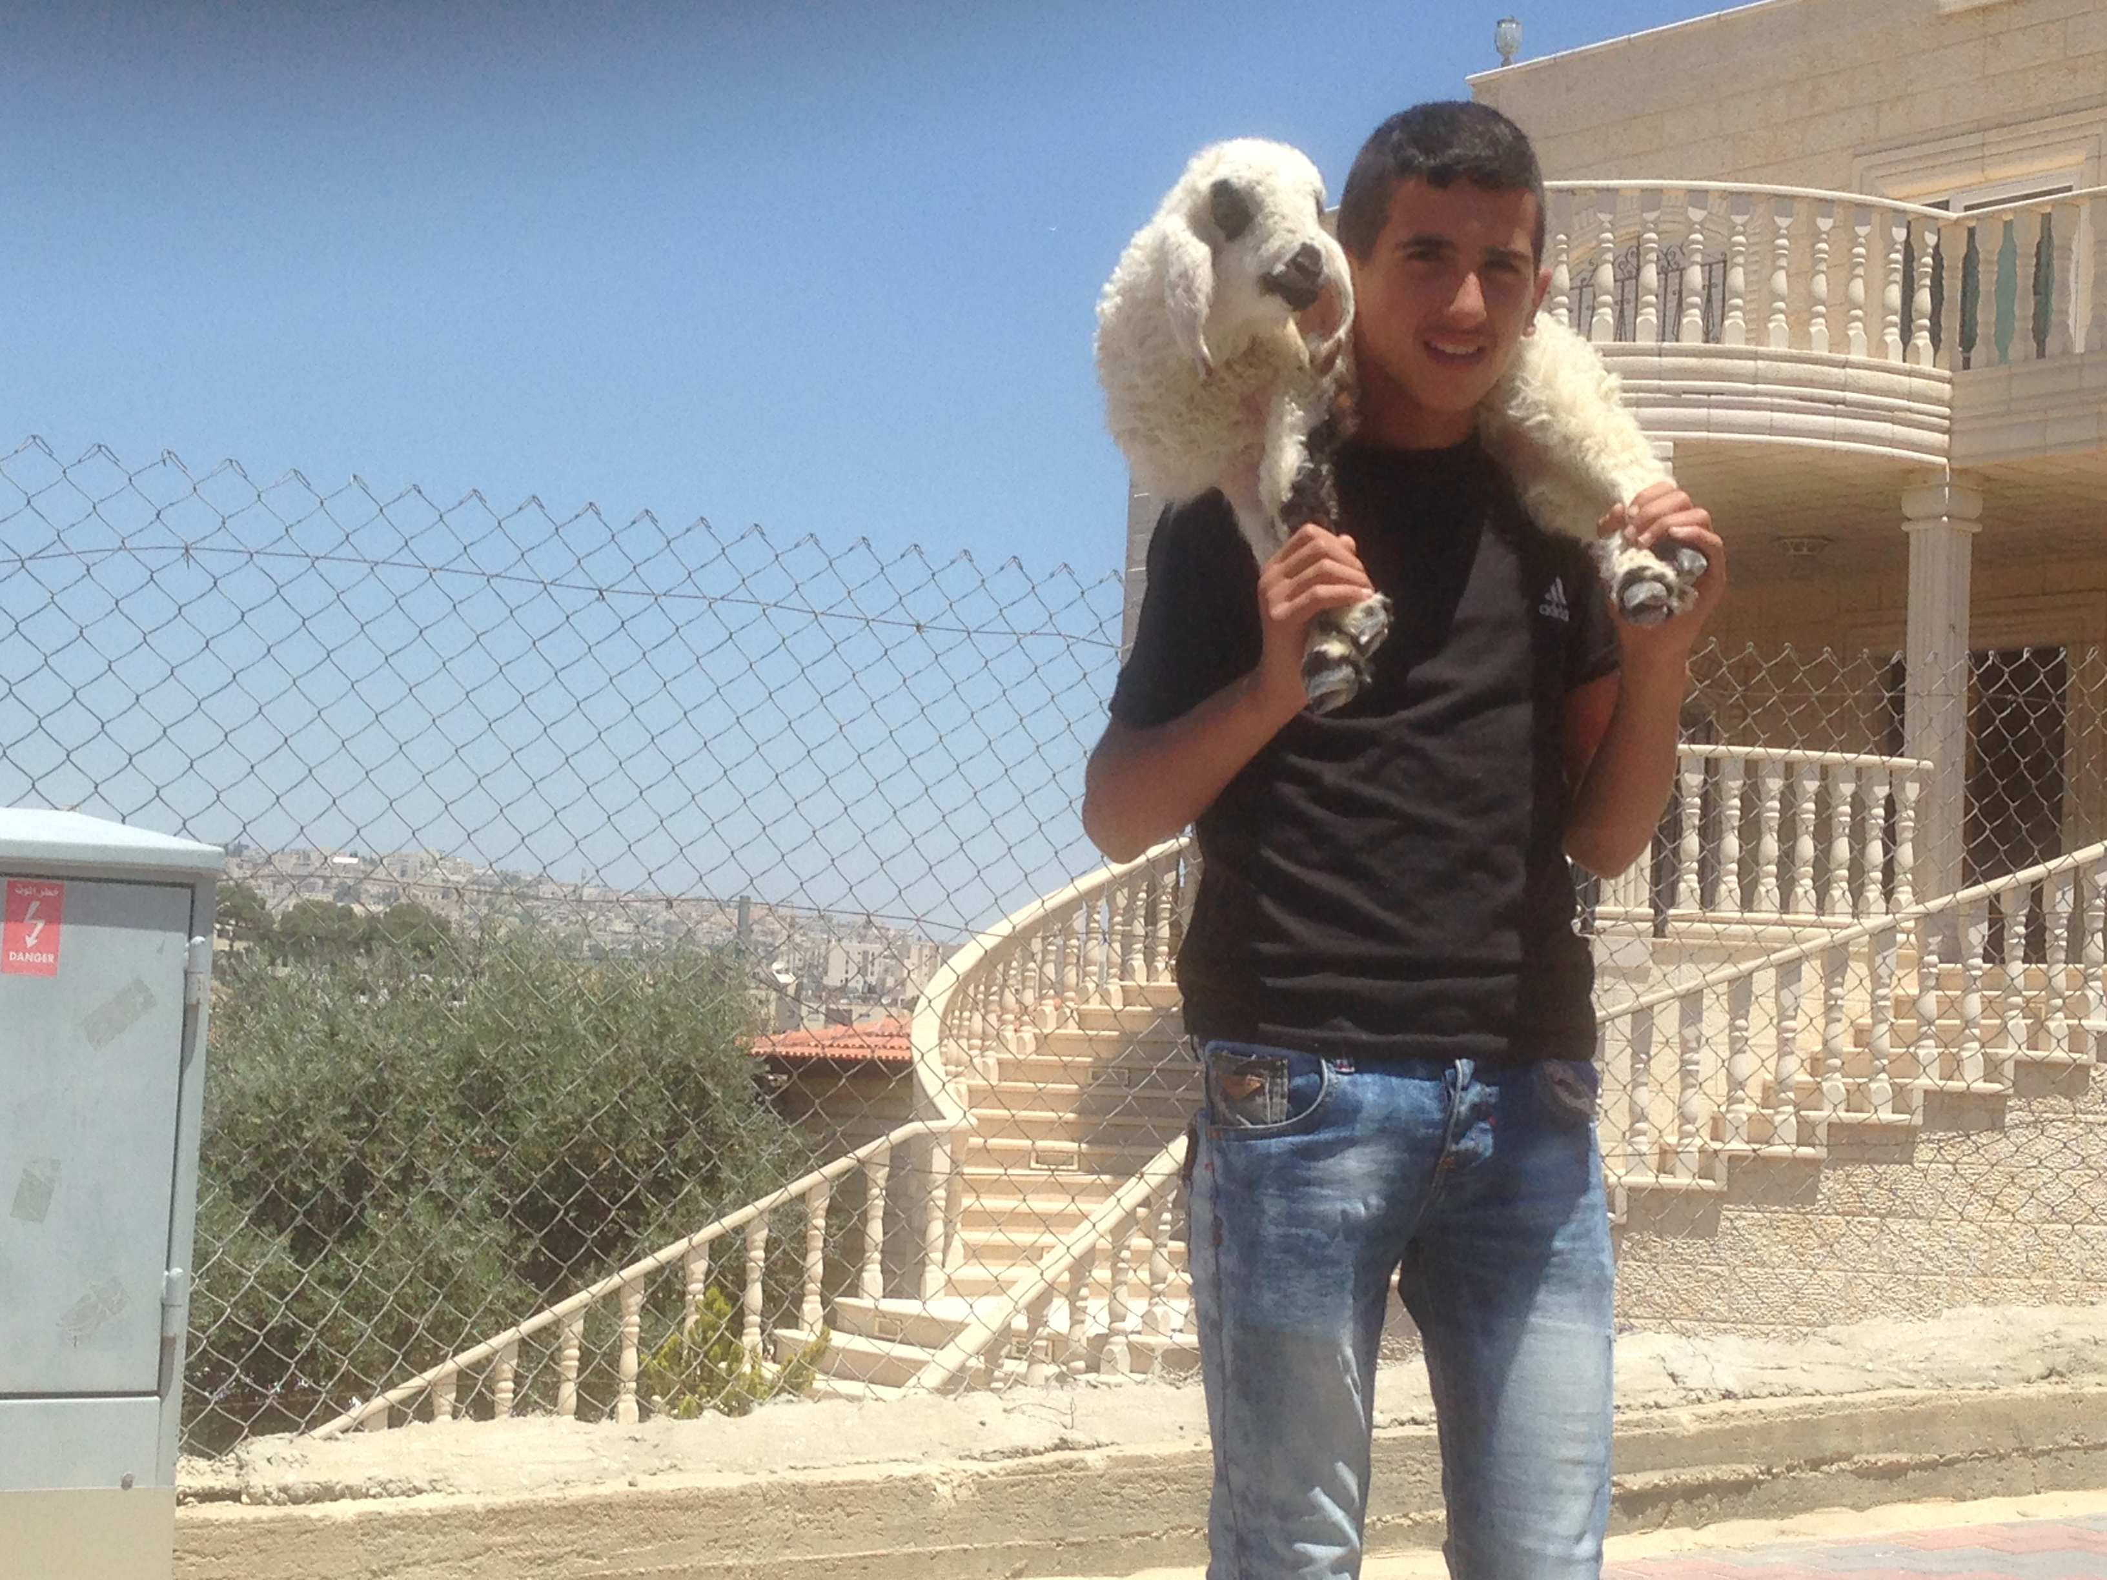
Israel Through Palestinian eyes PT 1
By Bro. Jared Keyes

Slide 2
Sunday School class breakdown
Class I
Rev 9 and Islam
Class II
Israel and the land
The ottoman empire
Balfour declaration
1948
1967
The Intifada I and II
Class III
Israel today and the Palestinians

Slide 3
The Prophesy of Revelation 9

Slide 4
Daniel’s Image
Birth
of Christ
Matt 1:1
70yrs
516 BC – 332 BC
332 BC – 4 BC
Approx 400 years
370AD
Approx 400 years
300AD – 1400 AD
Approx 1000 years
Babylonian
Captivity
Rebuilding
of
the wall
and
Temple
Rule of
Alexander
the Great
Geek Empire
Beginning
of the
Roman
Empire
Roman
Empire
Byzantine
Empire

Slide 5
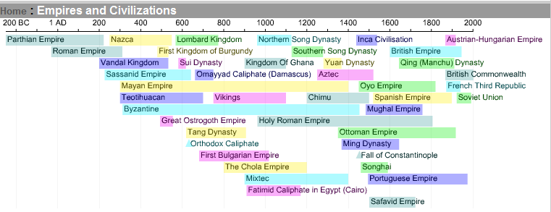
Timeline
We Examine the End of the Roman empire into the Byzantine empire.
We will later look at the end of the Ottoman empire to see where these Arabs and Muslims ended up and how they play a role in the Land of Israel

Slide 6
Biblical warnings
AWAKE
The night is far spent
The Day is at hand
Phophesy can wake us out of out sleep
Especially as we know that the time is near

Slide 7
Biblical Warnings
Watch therefore
It will come suddenly
Watch
Everyone one of us a personal responsibility to watch for the signs of his coming

Slide 8
Prophesy will shine a light in a dark place
It is our own fault if we don’t have the light of prophesy in our heart.
2Pet 1V19

Slide 9
5th Trumpet
Angel sounds the 5th trumpet
is given this key –(symbol of power) to of the bottomless pit

Slide 10
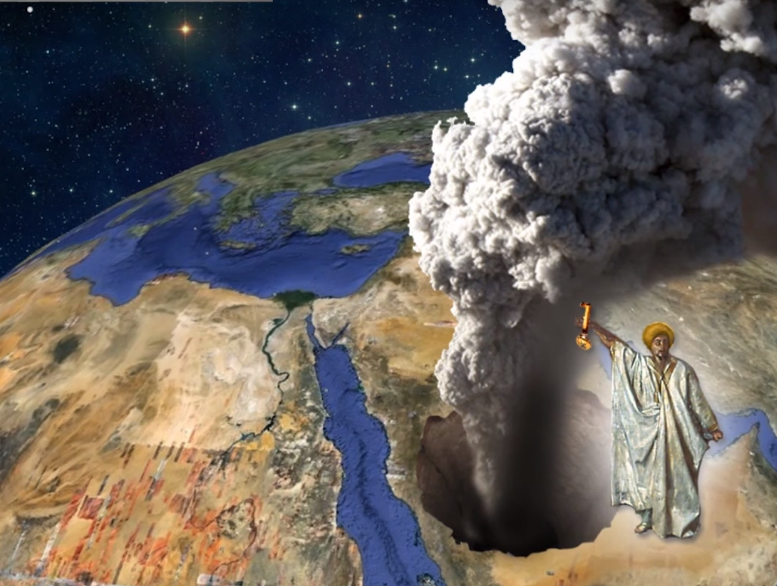
The bottomless pit opens up
Fire and smoke come out
Given the key or the power to change the heavens (sun and the moon are to be darkend)
The Key usually refers to the rulership
Hear o heavens hear o earth
Rev 3V7 Jesus is given key of David – a symbol of power
The bottomless pit – out of it come all these judgements of almighty God
And he opened the bottomless pit; and there arose a smoke out of the pit, as the smoke of a great furnace; and the sun and the air were darkened by reason of the smoke of the pit. Rev 9V2

Slide 11
The Furnace
Deut 29V 20 The LORD will not spare him, but then the anger of the LORD and his jealousy shall smoke against that man, and all the curses that are written in this book shall lie upon him, and the LORD shall blot out his name from under heaven.
2Thes 1:8-9 In flaming fire taking vengeance on them that know not God, and that obey not the gospel of our Lord Jesus Christ:
9 Who shall be punished with everlasting destruction from the presence of the Lord, and from the glory of his power;
Is 66v15-18 For, behold, the LORD will come with fire, and with his chariots like a whirlwind, to render his anger with fury, and his rebuke with flames of fire.
16 For by fire and by his sword will the LORD plead with all flesh: and the slain of the LORD shall be many.
17 They that sanctify themselves, and purify themselves in the gardens behind one tree in the midst, eating swine's flesh, and the abomination, and the mouse, shall be consumed together, saith the LORD.
18 For I know their works and their thoughts: it shall come, that I will gather all nations and tongues; and they shall come, and see my glory.

Slide 12
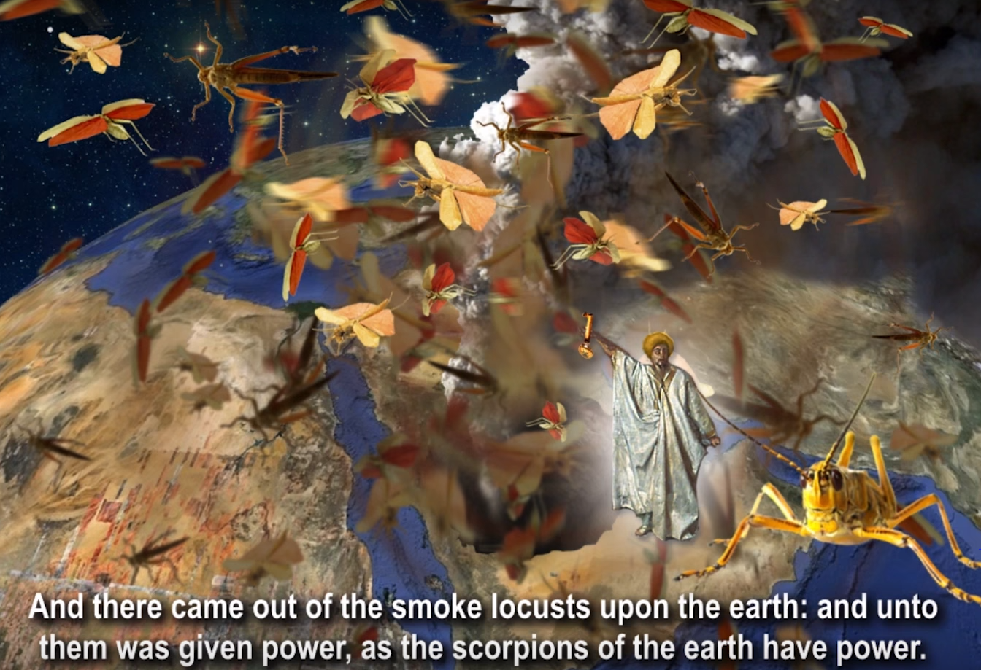
Out of pit come out Locusts
Unto them was given power
As scorpions are given power
Strongs #0200 akris {ak-rece'}
almost every spring are carried by the wind from Arabia into Palestine, and having devastated that country, migrate to regions farther north, until they perish by falling into the sea.
A power the would arise out of the area of Arabia
REVELATION 9V3

Slide 13
A King shall reign over them Rev 9V11
Seems like a paradox
Locust have a king over them but in Proverbs locust have no king
Apollyon = Destruction
King = Prince, commander, lord of the land
This destroying angel goes forth from this point as a hereditary leader of their own race and rise up from the area of Arabia

Slide 14
Who inhabited the area of Arabia?
Ishmael's son Gen 16V11-12
He is later cast out

Slide 15
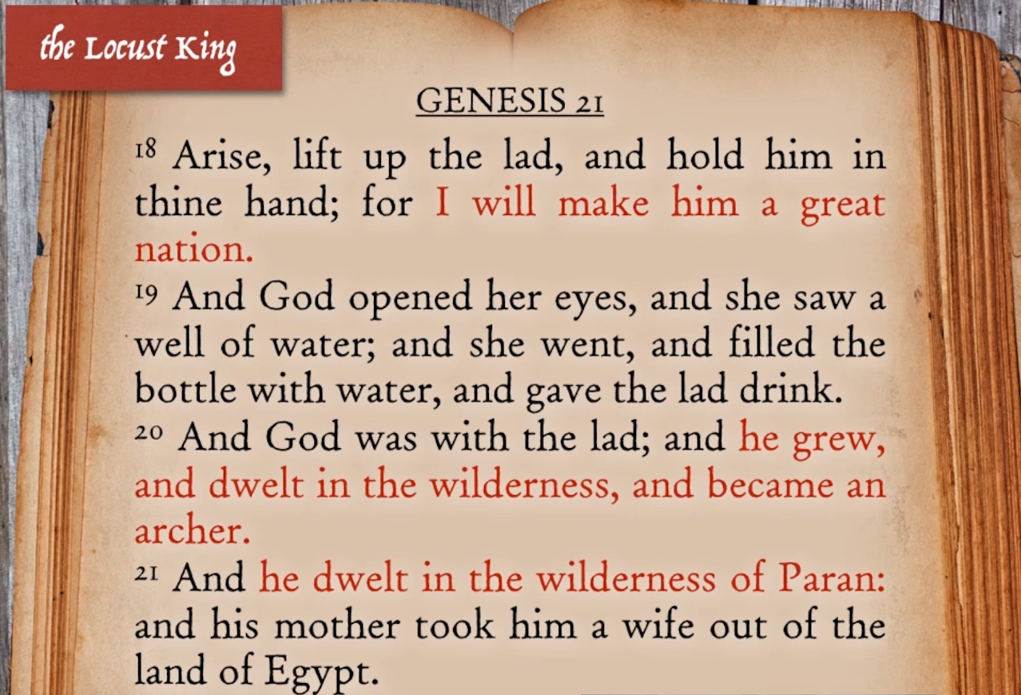
He would become a great nation
This is the great nation that would come out of the area of Arabia
A group of people that normally do not get along very well together but somehow be led by this great King.

Slide 16
The Star that fell from heaven Rev 9:1
This star helps us understand who this King might be.
The star falls and then all these judgements are to follow
The Judgment from this angel is against the Roman Empire and the King is Mohammed

Slide 17
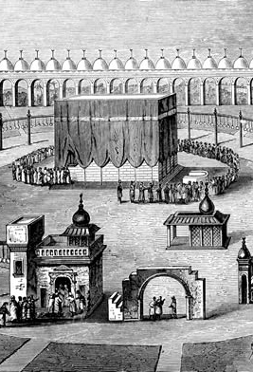
People walking around Mecca
https://youtu.be/yCAvorxz7Hw
Why do they walk around Mecca
The answer is the Kaaba – means cube
A black stone believed to be a meteorite that fell from heaven! It was worshiped by the arabs, they collected it and built this shrine around it.
They set up 360 idols circling around it and they circle it 7 times known as the Tawaf which trace the direction of the sun.
Attempts have been made to establish a connection between the act of ṭawāf and orbiting motions of heavenly bodies. It has been proposed, for example, that the act of ṭawāf closely resembles the shape of a galaxy when viewed from above - wikipedia

Slide 18
Mohammed lived in Mecca
Raised by his uncle Hamza ibn Abdul-Muttalib – his mother and father had died
Instead of getting rid of the stone he rebranded it.
HE claimed it was the last remaining piece (stone) of the alter that Abraham built with his son Ishmael
So he set it up to be reverenced.
Hence the connection to Rev Ch 9!

Slide 19
Who was Mahammed?
According to biographies of Muhammad,^{[which?]} while on retreat in a mountain cave near Mecca (the cave of Hira), Gabriel appears before him and commands him to recite the first lines of chapter 96 of the Quran. Muhammad's experience is mentioned in the Quran 53:4–9:
"It is no less than inspiration sent down to him:
He was taught by one Mighty in Power,
Endued with Wisdom: for he appeared (in stately form);
While he was in the highest part of the horizon:
Then he approached and came closer,
And was at a distance of but two bow-lengths or (even) nearer;"
Mohammed claimed to have been visited by the angel Gabriel in a cave at Mount Hira in 610AD
According to biographies of Muhammad, while on retreat in a mountain cave near Mecca (the cave of Hira), Gabriel appears before him and commands him to recite the first lines of chapter 96 of the Quran. Muhammad's experience is mentioned in the Quran 53:4–9:
"It is no less than inspiration sent down to him:
He was taught by one Mighty in Power,
Endued with Wisdom: for he appeared (in stately form);
While he was in the highest part of the horizon:
Then he approached and came closer, QURAN 53:4-9
Mohammed could not read! He was illiterate.

Slide 20
Who was Mohammed
Mohammed believed in Monotheistic God
Islam (every Muslim – Arabic for Islam) means to surrender or to submit
A muslim is a submitter
They were to submit to the one God and to his prophet Mohammed
Unlike today where the Arabs have 360 idols

Slide 21
The legend continues with Mohammed being taken to Jerusalem …
He falls asleep and was transported to Jerusalem to the temple Mount
Then taken on a fiery horse to heaven where he was to meet Jesus, Moses and Abraham
Glory to (Allah) Who did take His Servant for a Journey by night from the Sacred Mosque to the Farthest Mosque (Masjid al-Aqsa), whose precincts We did bless,- in order that We might show him some of Our Signs: for He is the One Who heareth and seeth (all things). S. 17:1
He was never taken there!
The dome of the rock is the 3rd holiest sight in Islam – Al Asqe Mosque
Now said to be the place where Ishmael was sacrificed – no longer Isaac!

Slide 22
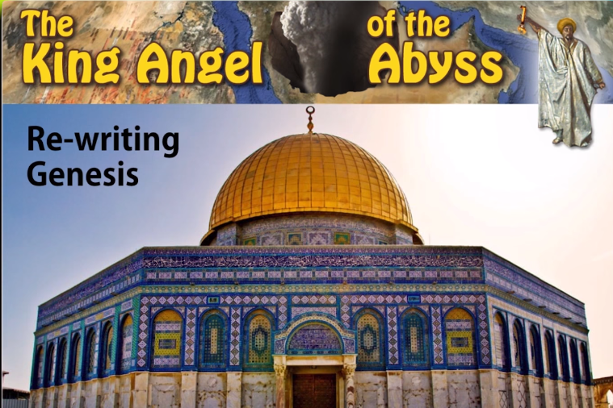
Why is sight so sacred?
More rebranding
The dome of the rock is the 3rd holiest sight in Islam – Al Asqe Mosque
The Koran does not mention who was sacrificed at that rock.
Now said to be the place where Ishmael was sacrificed – no longer Isaac!

Slide 23
Mohammed quest to clean up the idols
He went around and destroyed all the pagan idols
Most did not like that
So he fled for his life from Mecca
622AD he fled to Medina
Hijra – is now the pilgrimage every Muslim must make back to Mecca once in their lifetime at least

Slide 24
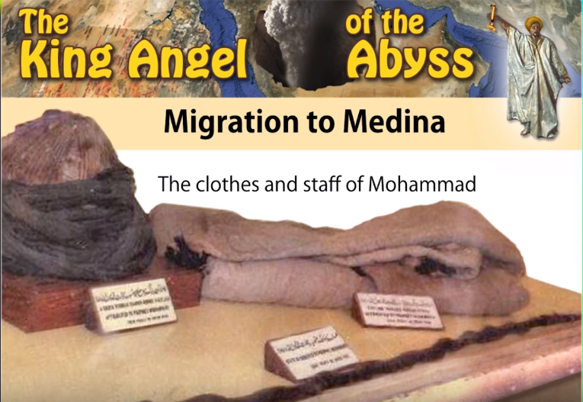
The clothes and staff of Mohammed
Constitution of Media
Hat, Coat and scarf

Slide 25
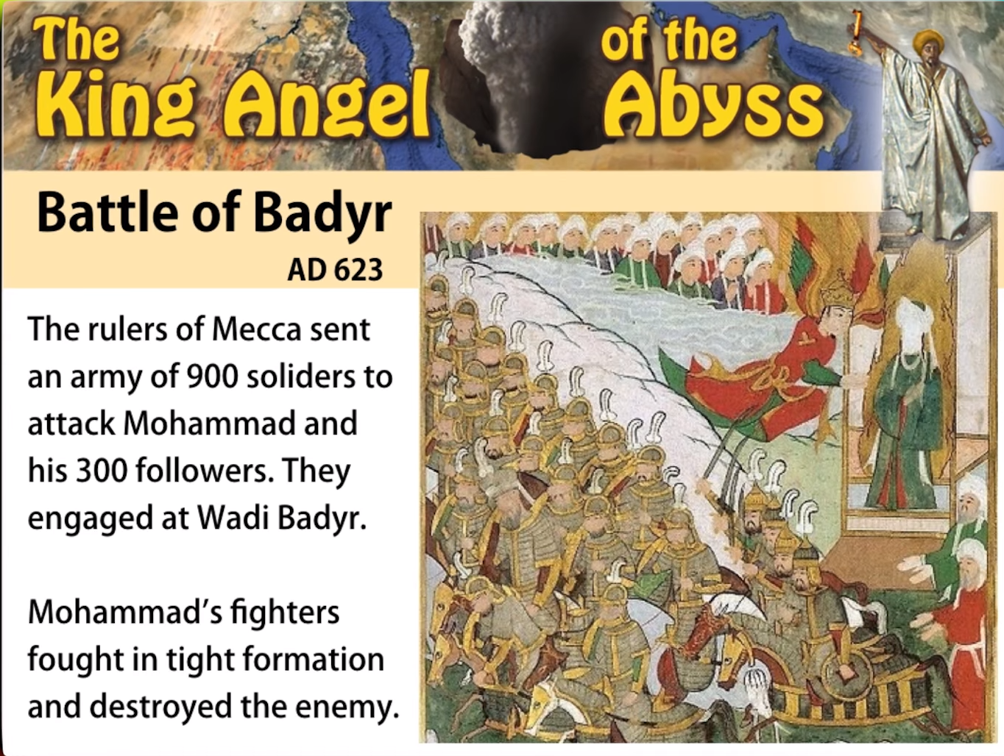
Ramadan is established
The rulers of Mecca are angry that he destroyed all their idols.
900 vs 300.
Mohammed won
Set up a fast called Ramadan

Slide 26
The final battle and the beginning of Islam
He then heads back to Media
Fights 10000.
At last the “fire” is kindled in the furnance.
Same word used in Rev 9:2
Smoke arouse in the furnace
He became their King

Slide 27
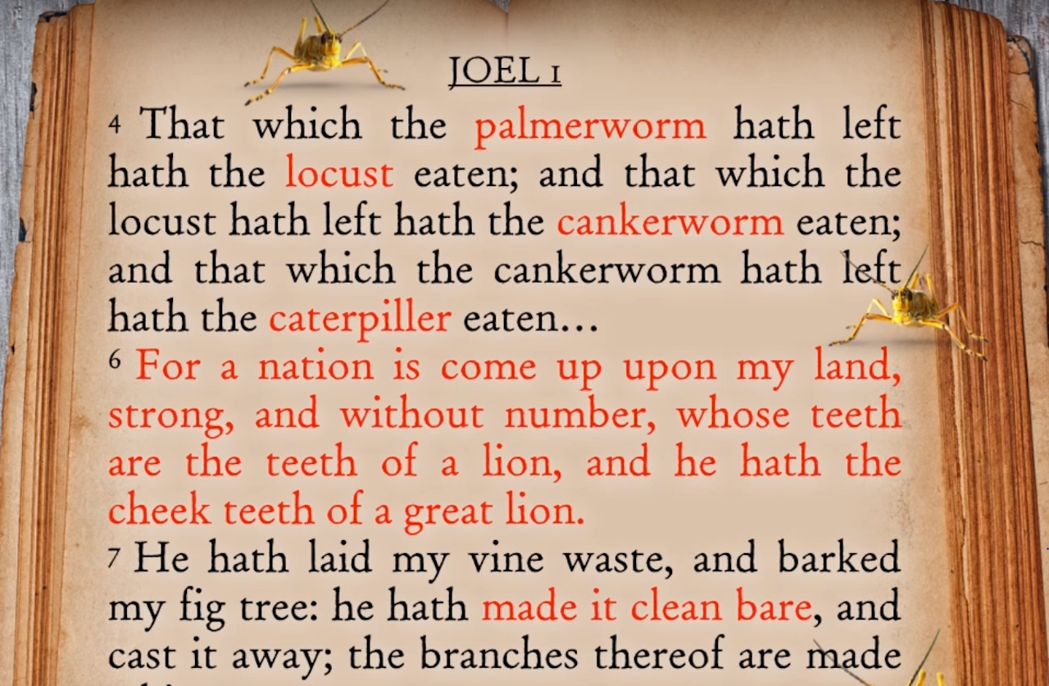
Out of this area came the Locusts
Different time period but in Joel but it describes what locusts will do.
Different stages of the locusts

Slide 28
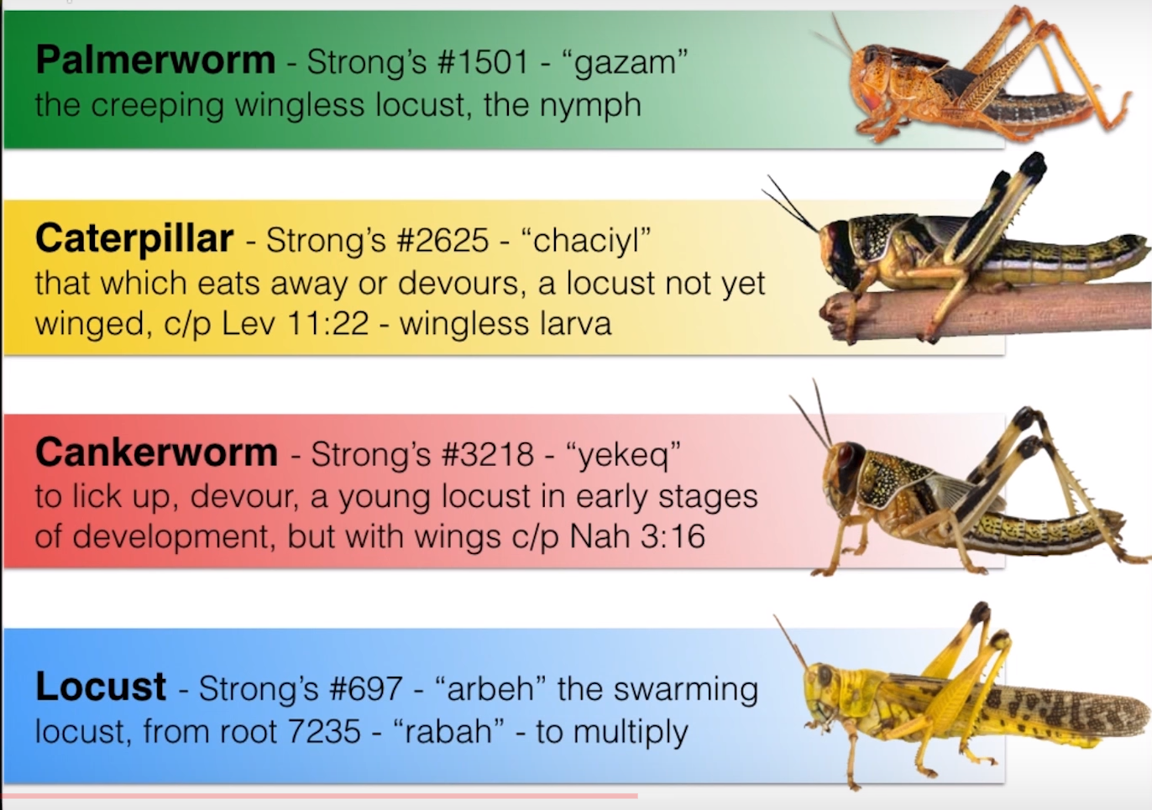
The stages of the Locust

Slide 29
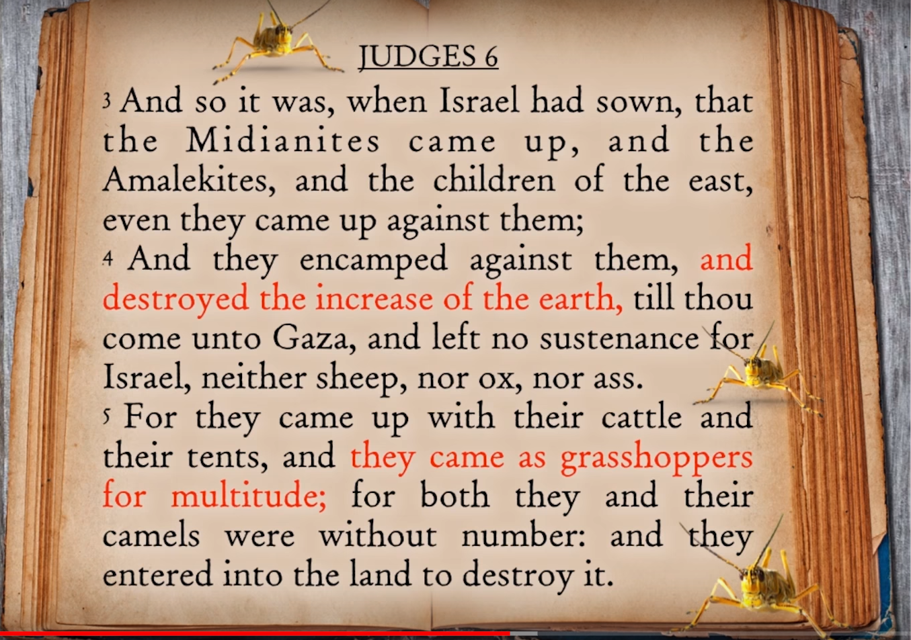
Locusts are used in the bible many times
The Midianites came from the area of Arabia
In Joel 2:3 they come like a cloud of darkness
Like a fire from a furnace

Slide 30
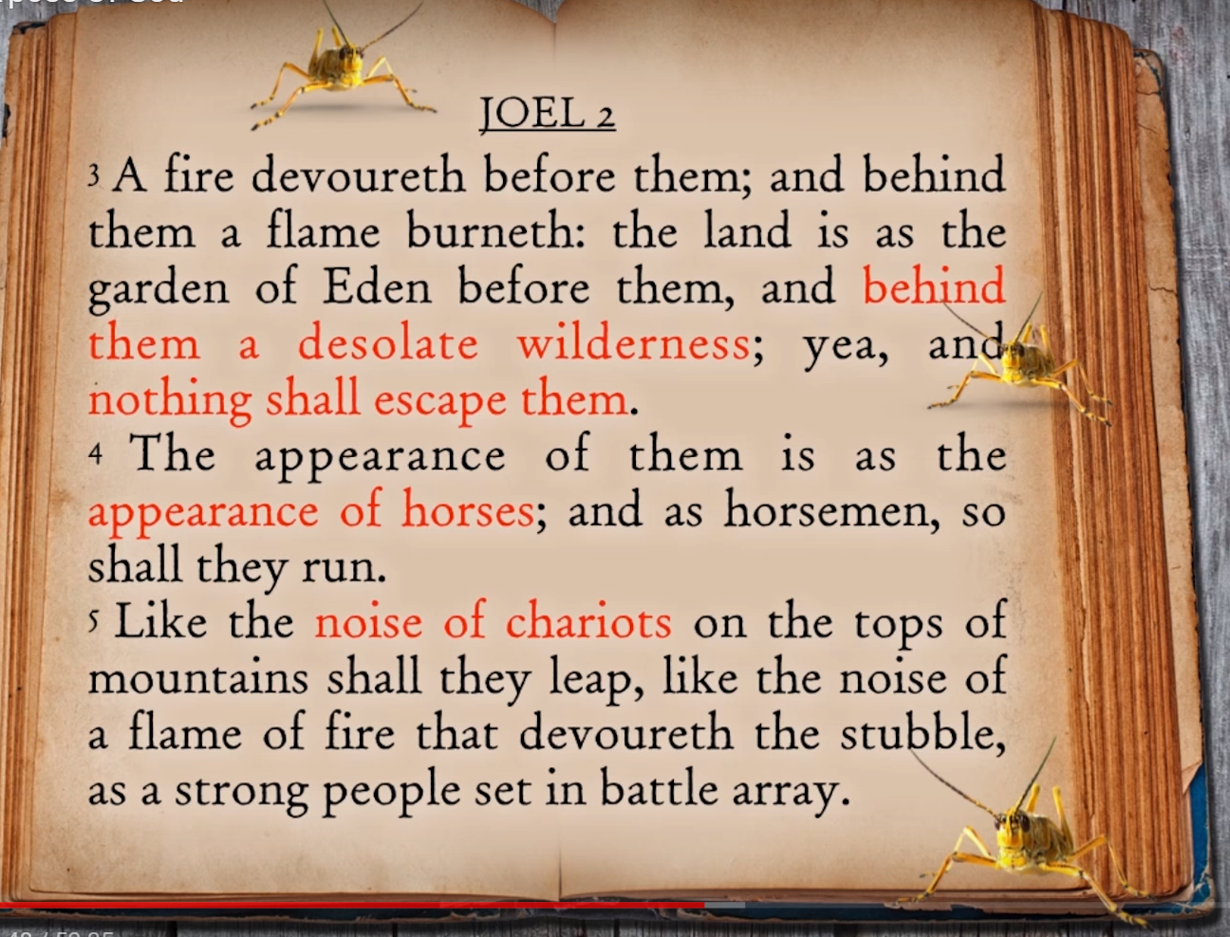
Joel 2

Slide 31
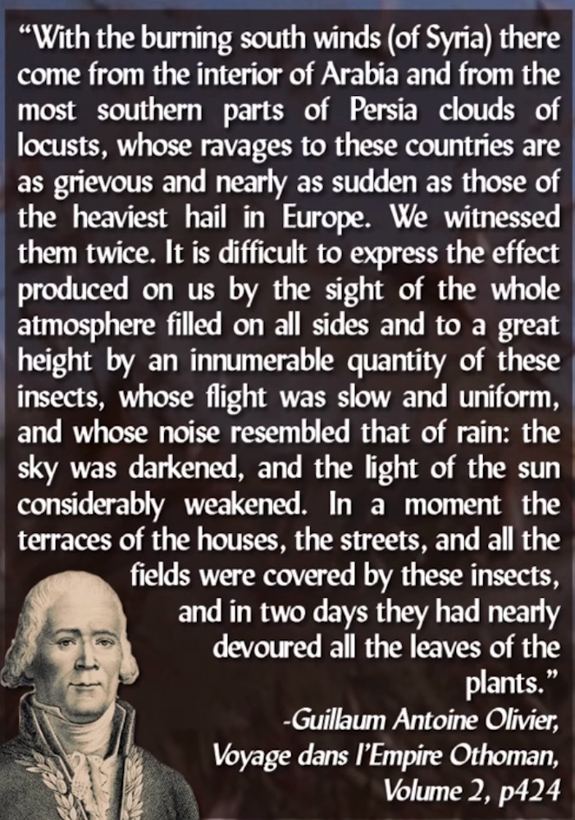
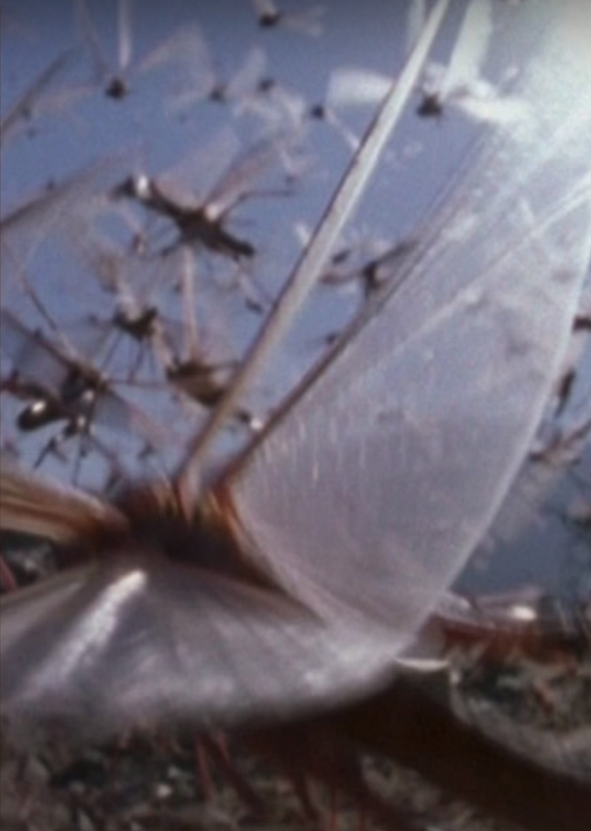
Quote from the ottoman empire
Wipe everything out!

Slide 32
What were the locust like
They were like horses running to battle

Slide 33
The rough caterpillar (the earlier form of the locust)
Jeremiah likens the locust to a horse
The dictionary says that the head of the locust is like that of a horse.
The Italians call the locust a cavelette – A little horse

Slide 34
What does this mean?
…”were like unto horses prepared unto battle”
Tells us their army is an army of calvary
The armies of Islam were mounted Calvary
Have on their heads crowns of gold.
In the Koran they were to ware the golden turban.
They were not suppose to cut their hair
They were to have teeth like a lion

Slide 35
Ali ibn Abi Talib
Hints that These people were like the teeth of a lion
Ali ibn Abi Talib

Slide 36
They had to use coats of mail or breastplates of Iron

Slide 37
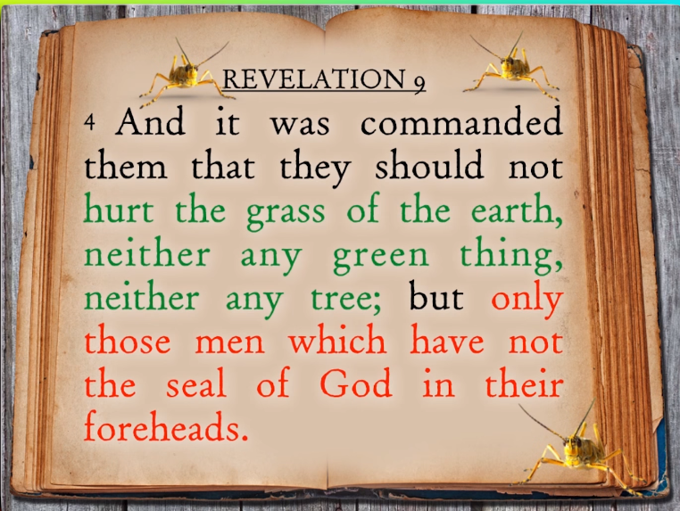
What was mission of Islam?
Two things that run parallel in revelation:
Mark of the beast in the forehead and all that goes with it
The teaching of Catholicism and all that goes with it
Destruction, pillage etc
The seal of God and all that goes with it
Fruits of the spirit

Slide 38
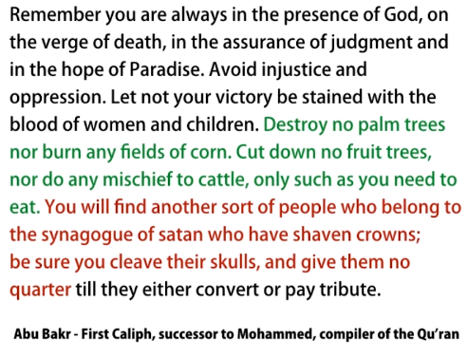
Abu Bakr
The first successor to Mohammad
Reigns a very short period of time
He fought against those who were against Mohammad
Decided to attack the Byzantine empire
They attack those who had the mark of the beast

Slide 39
Conquests
Follow Abu Bakr
4050 cities taken during his reigin
Palestine, Syria, Parts of the Persian empire
Empire stretched from Lybia to India

Slide 40
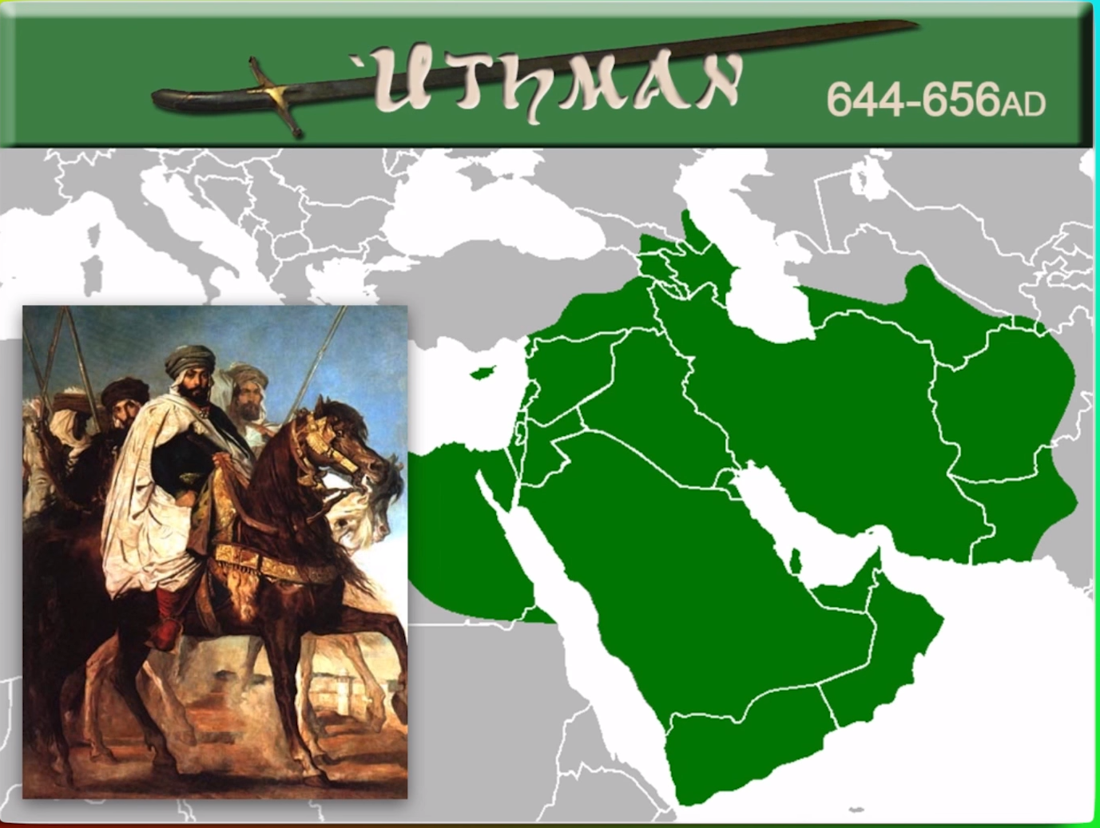
Conquests
Uthman succeeds Umar
Put the Koran together
Great conqueror
Pushes the envelope from Pakenstan to northern part of Africa
Wants to take Constantinople but is assassinated before that took plan

Slide 41
Forth Caliph
Started the Shite or Shias
Believed that you must be a direct descendant of Mohammad in order to be a ruler (Caliph)
Sunnis believe that you must be appointed by someone from Mohammed's tribe in order to be a Caliph
They have ben fighting ever since
Eventually killed

Slide 42
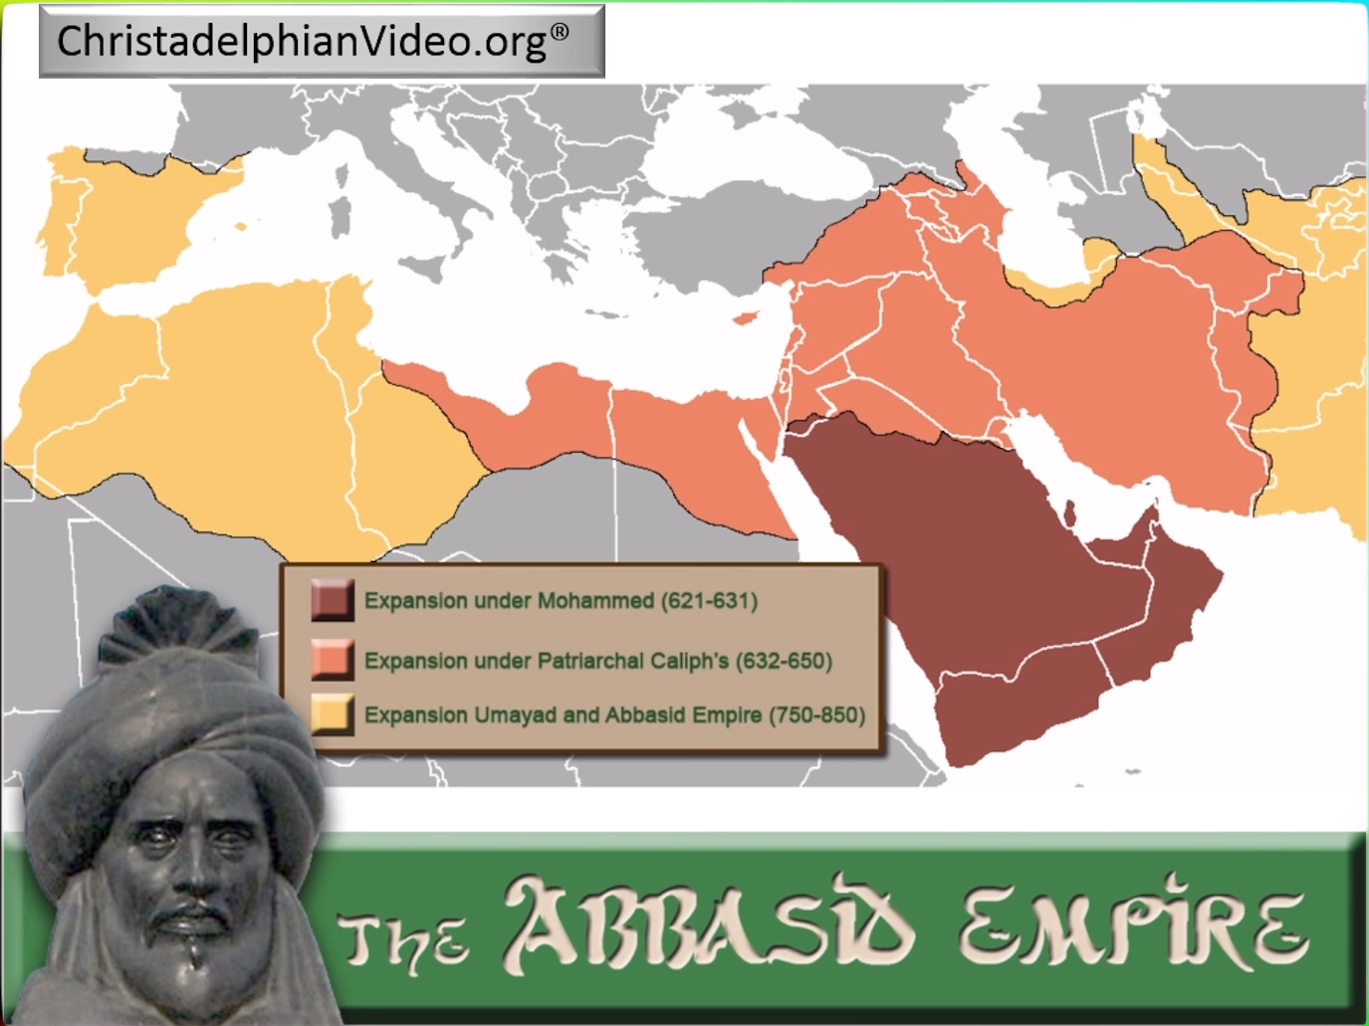
The beginning of the Golden age of Islam
The Abbisid Empire is the second phase of Islam
Considered the golden age of Islam
Started in 750AD – Harun al-Rashid – the first Caleph
His son Al-Mansur, 2nd Caleph of the Abbasid empire was the real person behind the empire.
Establishes capital in Bagdad
750AD to 1258AD when the Moguls come in

Slide 43
House of wisdom Established
All the worlds knowledge translated into Arabic
Western Roman culture would have been lost. They conserved it all when the Romans became savages and lost the ability to read and write.
Like Alexandra the Great collected all the knowledge of the Greek world

Slide 44
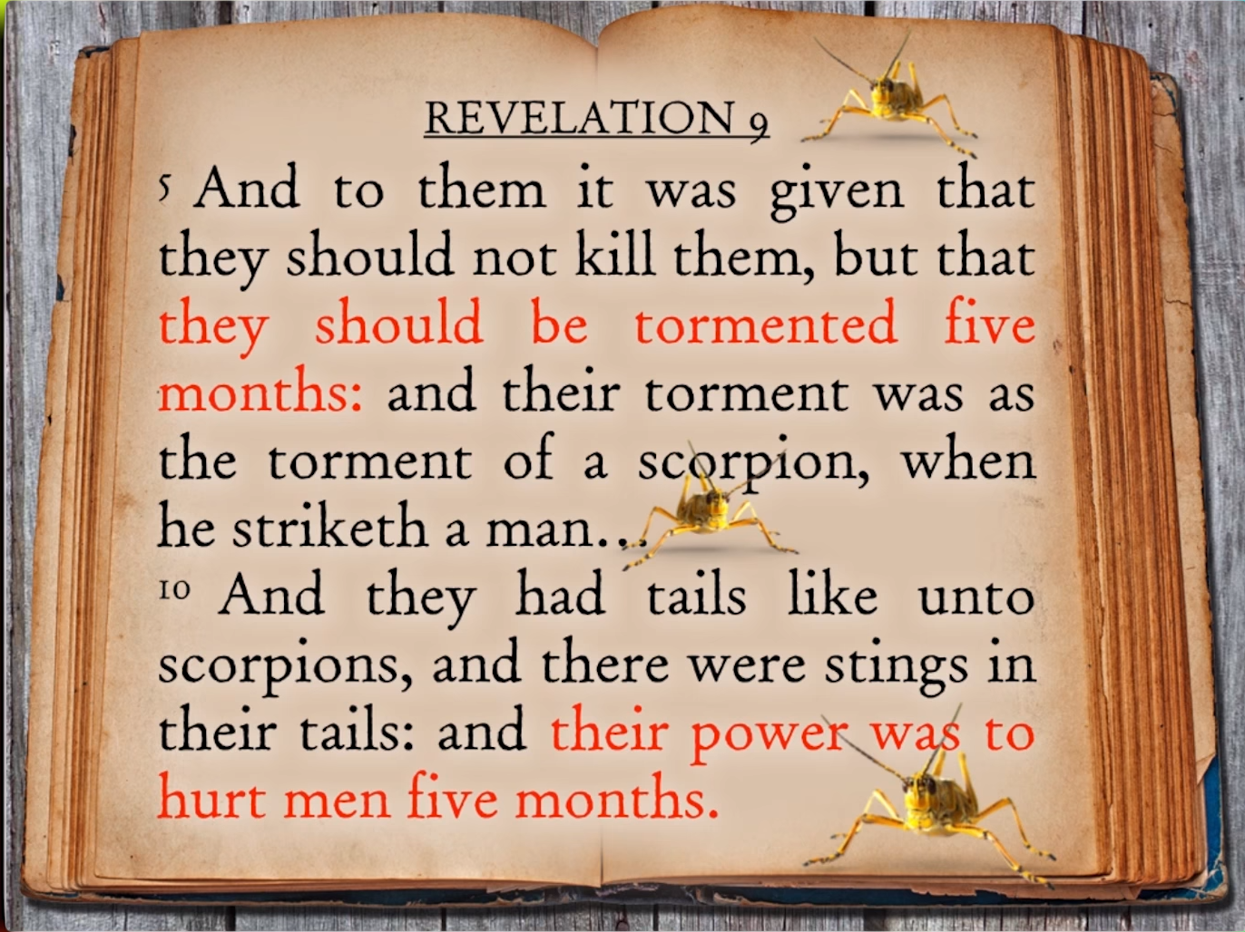
How long would this empire last?
5 Months
The same life span of a Locust
Factual with Biology

Slide 45
Two stages of judgement
632 – 782 is the first period of Islam from Mohammed Rev 9:5
782-933 Is the Abbasid empire in Bagdad
The empire still existed but it power to control the surrounding area ended

Slide 46
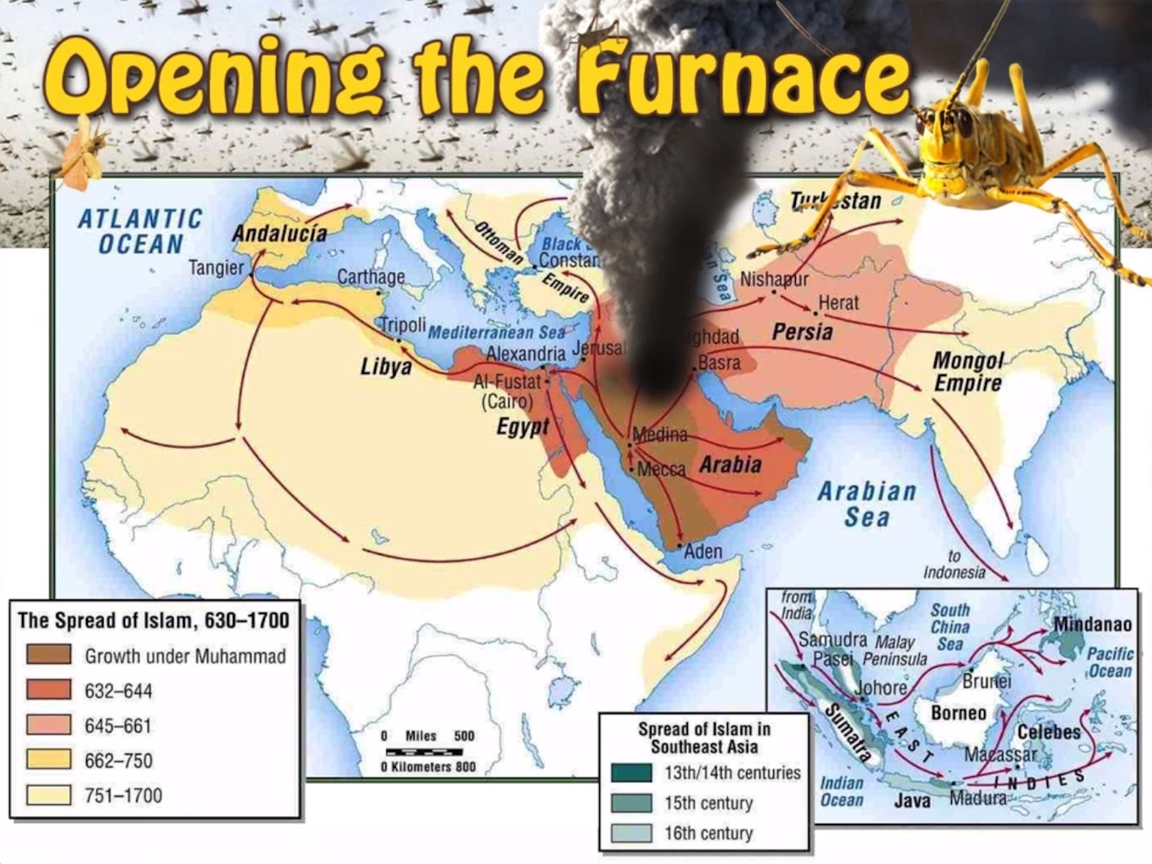
The furnace opened up
In that furnace Islam was born and proliferated into all these regions into what we have today.
This is the background that leads us to the modern history of people who believe in Islam.
They came from Arabia and extended even into Palestine.

Slide 47
Islam in Prophesy commented by other groups and people
John Wesley’s brother, Charles Wesley wrote some of our hymns
Saracens = Another name Arab Muslims

Slide 48
Islam in Prophesy commented by other groups and people
Mostly Protestant writers who also had something in common with the Islam – they wanted to combat and protest against Catholicism. And they used Revelation to proved it.

Slide 49
Everything that is mentioned in the Rev 9 detail tells us about the Arabs and how they started
The details of the head of the locust
1
The details of the horses
2
The details of their hair
3
The details of turban
4
The details of their empire
5
The details of the time they would reign
6

Slide 50
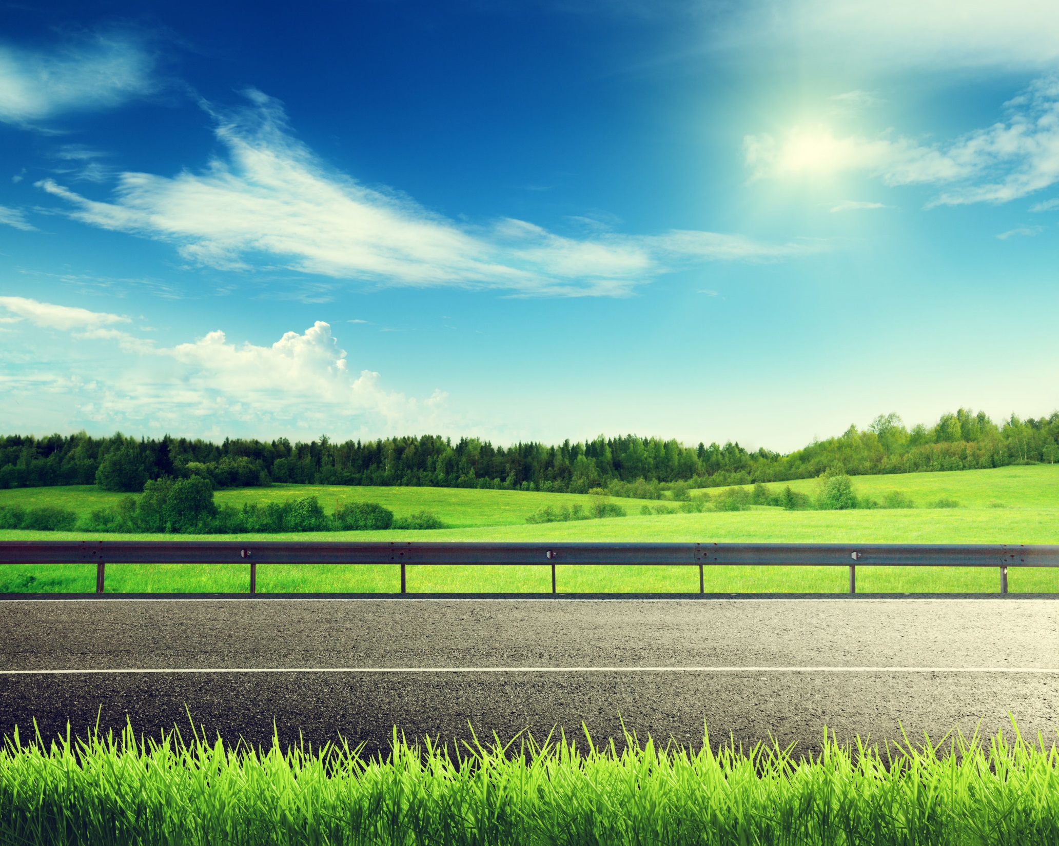
Questions?

